Slide 1
1
Agri-Jobs 4 Youth Business Model Selection
Kenya

Slide 2

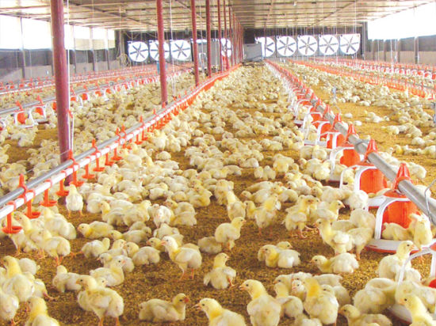
Kenya Business Model Selection:
Poultry Value Chain

Slide 3

Business Model Selection - Poultry Farms
Poultry Value Chain Map
Small and medium scale poultry farms have the highest market share in the retail trade
Day Old Chicks and Feed | Primary Production | Wholesale /Processing | Slaughterhouses | Retail Trade
Day old chicks 70 % . Large scale hatchery farms from Nairobi.
Rural households (80% market share in local chicken).
Open Markets. Capacity 200-500 chickens weekly.
Open Markets
Small scale distributors. Capacity 300-500 chickens per week.
Small commercial poultry farms. Annual capacity 600 - 6,000 chickens.
Medium slaughterhouses Capacity 500-2000 chickens weekly
Day old chicks 30%. Regional (Small and medium size hatchery farms and incubators).
Medium scale distributors. Capacity 500 -3000 chicken per week.
Small Shops
Medium commercial poultry farms. Annual capacity 6,000 - 70,000 chickens.
Poultry feed 80 % . Large scale producers in Nairobi.
Large l scale distributors. Capacity >3000 chickens per week.
HoReca
Large slaughterhouses Capacity >200 chickens per day.
Large commercial poultry farms Annual capacity >60,000 chickens. (around 5% market share).
Poultry feed 20 % . Regional small and medium feed mills.
Processing Companies.
Supermarket Retail Chains
Veterinary Service Providers

Slide 4
Overview Of The Business Models In The Poultry Value Chain.

Slide 5
Business Model 1: Small Poultry Farm (Broiler and Local Improved Chicken).
Product or Service
Product or Service
Employment Impact
Annual production capacity of 5,000 live chicken per farm.
Production scale up capacity up to 10,000 live chickens per farm.
Broiler chicken production process:
  Production cycle duration-35 days.
  Production cycles per year-10 cycles.
  Production capacity per cycle-500 chickens.
  Live weight at 35 days is 2.2 kg/ chicken.
Local improved chicken production process:
  Production cycle durairotn-120 days.
  Production cycle per year-3 cycles.
  Production capacity per cycle-1600 chickens.
  Live weight at 120 days is 2.0 kg/ chicken.
Farm sells live chickens to traders and wholesalers, no on-farm processing
Farms buy high quality day old chicks and feed mills from processing companies, no on farm processing.
High cost of raw materials to produce good quality feed mill.
Limited access to finance for start up farmers.
Lack of knowledge about modern primary production practices.
Lack of knowledge about business management and marketing.
Investment cost per business model EU 4,000
Opportunity to create 3 FTE per business model.
Growing poultry market provides space for 2,000 small poultry farms.
High employment opportunity for youth and women.
Total new FTE opportunity 6,000.
Opportunity to create additional 10,000 indirect full-time jobs in:
  Poultry feed processing.
  Agricultural extension and vocational education.
  Veterinary services.
  Primary production of maize and soybean.
EUR 1 million investment in the value chain will create:
  750 full time jobs.
  250 new business.
Entry Point
Potential partners: young entrepreneurs interested in in the poultry business and rural households interested in up-scaling. The existing large scale commercial poultry farms, feed mills and TVET colleges.
Support needed: technical training, co-matching grants, business skills development & coaching and market linkages.
Barriers to Entry

Slide 6
Business Model 2: Medium Poultry Farm (Broiler, Local Improved Chicken or Table Egg Production).
Product or Service
Employment Impact
Annual production capacity of 20,000 live chicken per farm.
Production scale up capacity up to 60,000 live chickens per farm.
Broiler chicken production process:
  Production cycle duration-35 days.
  Production cycles per year-10 cycles.
  Production capacity per cycle-2,000 live chickens.
  Live weight at 35 days is 2.2 kg/ chicken.
Local improved chicken production process:
  Production cycle durairotn-120 days.
  Production cycle per year- 3 cycles.
  Production capacity per cycle-6,000 live chickens.
  Live weight at 120 days is 2.0 kg/ chicken.
Table egg production:
  Production cycle duration per chicken- 20 months/270 eggs
  Farm production capacity per cycle: -10,000 chickens/2.7 mln eggs
Farm sells live chickens to traders and wholesalers, no on-farm processing
Investment cost per business model EU 10,000.
Opportunity to create 6 FTE per business model.
Growing poultry market provides space for 800 medium poultry farms.
High employment opportunity for youth and women.
Total new FTE opportunity 4,800.
Opportunity to create additional 8,000 indirect full-time jobs in:
  Poultry feed processing.
  Agricultural extension and vocational education.
  Veterinary services.
  Primary production of maize and soybean.
EUR 1 million investment in the value chain will create:
  600 full time jobs.
  100 new business.
Entry Point
Potential partners: young entrepreneurs interested in in the poultry business and rural households interested in up-scaling. The existing large scale commercial poultry farms, feed mills and TVET colleges.
Support needed: technical training, co-matching grants, business skills development &coaching and market linkages.
Barriers to Entry
High cost of raw materials to produce good quality feed mill.
Limited access to finance for start up farmers.
Lack of knowledge about modern primary production practices.
Lack of knowledge about business management and marketing.

Slide 7
Business Model 3: Medium Integrated Poultry Farm Model (day old chicks, incubator and egg).
Product or Service
Product or Service
Employment Impact
Annual production capacity of:
  Day old chicks- 50.000 chicks.
  Hatchery Egg-10,000 eggs.
  Incubator-50, 000 eggs for own production.
  Incubator -30,000 eggs commercial orders.
Production scale up capacity up to 80,000 day old chicks per farm.
Farm has the diversified source of revenue:
  Selling day old chicks.
  Selling fertilized eggs.
  Incubation service fee.
  Service fee for growing the day old chicks
Incubation production process:
  Production cycle duration-21 days
  Production cycles per year-14 cycles
  Production capacity per cycle-6,000
Farms sell day old chicks and fertilized eggs to poultry farms and rural households.
Investment cost per business model EUR 30,000
Opportunity to create 8 FTE per business model.
Growing poultry market provides space for 400 medium integrated poultry farms.
Total new FTE opportunity 3,200.
High employment opportunity for youth and women
Requires skilled labor to manage efficiently incubator .
Opportunity to create additional 7,000 indirect full-time jobs in:
  Agricultural extension and vocational education
  Veterinary services
EUR 1 million investment in the value chain will create:
  240 full time jobs
  30 new business
Entry Point
Potential partners: Existing small and medium incubators and poultry farms who are interested to up scale business. Financial institutions, existing large scale commercial poultry farms, feed mills and TVET colleges.
Support needed: technical training in co-matching grants, business skills development &coaching and market linkages.
Barriers to Entry
High cost of electricity increases cost of production of incubation
Limited access to good quality maintenance and repairing services for incubator equipment.
Lack of knowledge related to efficient management of incubator.
Lack of knowledge about business management and marketing.

Slide 8
Business Model 4: Poultry Trade and Distribution.
Product or Service
Product or Service
Employment Impact
Annual trade and distribution turnover 10,000 live chickens
Trade turnover scale up capacity up to 20,000 day live chickens.
Traders mainly sells the chickens to small shops, directly to households and to smaller hotels and restaurants
Traders mainly sell the chickens in open markets and directly to urban households.
Some trades also sell the chicken to small shops, restaurant and hotels. are also retailers and sell live chickens in open markets or small shops
Traders buy chickens a mostly small and medium size poultry farms.
Most of the traders use motorbikes and tricycles to transport chickens from farm.
Currently a one-person job, but there is space for professional distributors running several vehicles with administrative and sales staff
Investment cost per business model is 700 EU to buy motorbike.
Requires small amount of working capital of 200 EU to buy chickens from farms.
Opportunity to create 1FTE (self employment) per business model.
Growing poultry market provides space around 3000 poultry traders.
High employment opportunity for youth.
Does not require high technical skills.
Total new FTE opportunity 3,000 (self-employment).
EUR 1 million investment in the value chain will create 1200 high value job (self-employment).
Entry Point
Potential partners: young entrepreneurs who are interested in the poultry business. Open markets, hotels and restaurant which are interested to buy improved local chickens from village farms.
Support needed: co-matching grants to buy motorbikes and market linkages development.
Barriers to Entry
In case of opportunity for full time job in other sector youth prefer to quit business activities in trading and distributions.
Banks do not finance traders.
MFIs work with traders but interest rate is high at average 10% more that in banks.

Slide 9
Business Model 5: Medium Poultry Feed Plant.
Product or Service
Product or Service
Employment Impact
Annual production capacity of 5,000-10,000 tons of poultry feed, plus mixing service for farmers who bring own ingredients.
Diversified source of revenue:
Selling the poultry feed mill
Fee for raw materials mixing service
Different mixes for each stage in the growth cycle:
  Starter
  Growing
  Finishing
Maize and wheat are main components and imported pre-mix (minerals and vitamins).
Plant sells feed meal to small and medium poultry farms.
To increase the outreach of farmers plant can open small shops in the villages. This will require additional investments in infrastructure and as well recruitment of new staff.
Investment cost per business model EUR 25,000
Opportunity to create 5 FTE per business model.
Limited market growth opportunity does not create big opportunity to scale up business models and increase total employment.
Current market demand allows maximum 50 business models development
Total new FTE opportunity 250
Opportunity to create additional 1,500 indirect full-time jobs in:
  Primary production of maize and soybean.
  Agricultural extension and vocational education.
EUR 1 million investment in the value chain will create:
  200 full time jobs
  40 new business
Entry Point
Potential partners: Existing feed mills plant which are interested to scale up the business. Farmers producing maize, soyabean and sunflower . Small and medium poultry farms, TVET colleges and agricultural extension offices.
Support needed: co-matching grants, capacity building and training in good quality feed formation, market linkages development.
Barriers to Entry
High cost of raw materials such as maize and wheat makes very difficult to achieve the long-term financial sustainability of the business.
High market competition from large scale feed mill plants. Most of these plants are located in Nairobi.

Slide 10
Business Model 6: Medium Poultry Slaughterhouse.
Product or Service
Product or Service
Employment Impact
Annual production capacity of 30,000
Customer profile:
  Small and medium poultry farms.
  Large poultry farms.
  Rural households.
  Retailers in the open markets.
Source of revenue is slaughtering fee.
Farms bring the chicken to slaughterhouse.
Average time customer wait for slaughtering is 1 hour ( depends on the amount of chicken)
Investment cost per business model EUR 20,000
Opportunity to create 4 FTE per business model.
Limited market growth opportunity does not create big opportunity to scale up business models.
Current market demand allows maximum 20 business models development
Total new FTE opportunity 80
Limited opportunity to create indirect full time jobs.
EUR 1 million investment in the value chain will create:
  200 full time jobs
  50 new business
Barriers to Entry
Low market demand does not provide opportunity to scale up business.
Long term financial sustainability depends on ability of business model to increase scale.
Model can be profitable if plant also does the slaughtering of livestock.
In this case production management process is more complex and requires additional investment in equipment and skilled labor.
Entry Point
Potential partners: Existing small, medium poultry farms and retailers int the open market. Agricultural extension offices and county veterinary service offices.
Support needed: co-matching grants, capacity building and training veterinary safety standards and regulations.

Slide 11
Business Model 7: Poultry Meat Processing Plant.
Product or Service
Product or Service
Employment Impact
Annual production of 1000-2000 tons of processed and frozen meat.
Semi-automatic slaughtering line & cold storage
Two main types of customers:
  Small shops and supermarkets
  HoReCa
Three main types of products:
  Sausages
  Frozen full chicken
  Frozen chicken parts
High equipment cost lead to high investment cost per business:
  EUR 100,000-150,000 with Chinese equipment or 2nd hand EU equipment
  EUR 200,000-400,000 with new EU equipment
Opportunity to create 15 FTE per business model.
Limited opportunity to scale up business models.
Current market demand allows maximum 10 business models development.
Total new FTE opportunity 150.
EUR 1 million investment in the value chain will create:
  45 full time jobs
  3 new business
Barriers to Entry
Entry Point
Lack of local stock of spare parts and maintenance and repair service.
Lack of skilled labor who can work with the modern processing equipment.
Lack of institutions who can provide short -term training about operating and repairing the processing equipment
Potential partners: Existing small and medium poultry farms. TVET colleges and agricultural extension offices.
Support needed: training in technology transfer, co-finance, business skills development & coaching, access to finance, business linkages

Slide 12
Conclusion: Final Ranking Of Business Models.
Product or Service
Rank | Business model | Direct FTE | Indirect FTE | Complexity | Impact on other sector actors
1 | Small Poultry Farm | 6,000 | 10,000 | Low | Medium to high
2 | Medium Poultry Farm | 4,800 | 8,000 | Medium | Medium to high
3 | Medium Integrated Poultry Farm | 3,200 | 7,000 | Medium | Medium to high
4 | Distribution | 3,000 | 3,000 | low | Medium
5 | Medium Size Poultry Feed Plant | 250 | 1,500 | Medium | Medium
6 | Poultry Meat Processing Plant | 150 | N/A | Medium to high | Medium
7 | Medium Poultry Slaughterhouse | 80 | N/A | Medium | Low to medium

Slide 13
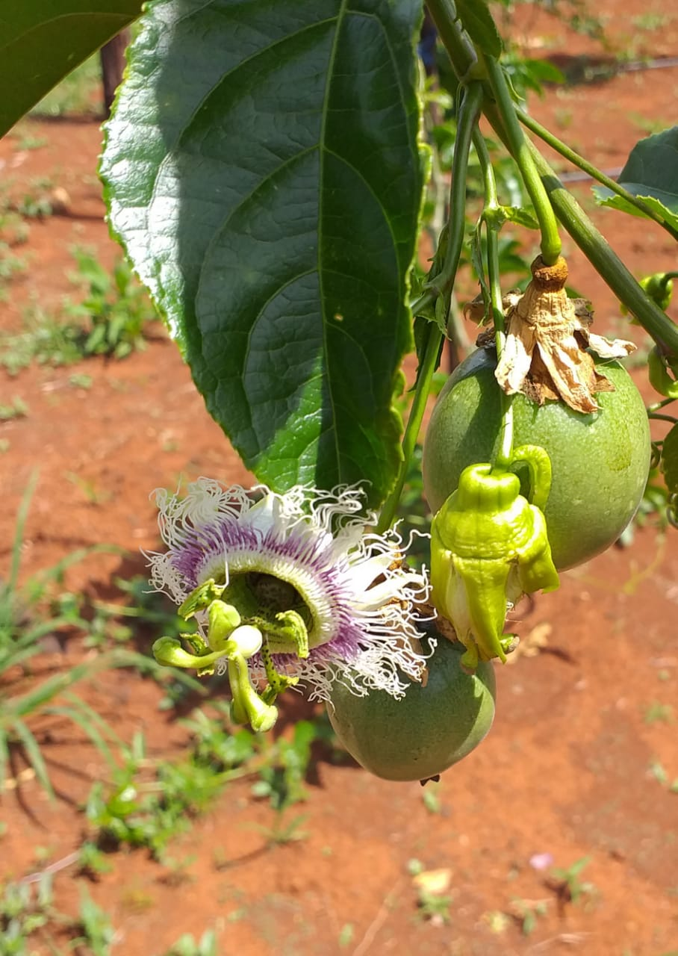
Kenya
Business Model Selection:
Passionfruit Value Chain

Slide 14



Issues and Opportunities in Passionfruit
Issues
Fusarium and Woodiness Viroid infest production areas
Farmers lack the GAP knowledge to grow passionfruit successfully
There is a shortage of professional nurseries
Certified seeds are difficult to find and there is a critical shortage of disease-free planting material
Land access for women and youth is difficult
Access to finance for investment for women and youth is difficult
Lack of access to assured markets discourages youth from persisting with passionfruit
Processors, local market traders and exporters struggle to reach scale
Below 20% of fruit is 1st grade suitable for export
Pesticide residues present a barrier to export
Opportunities
Passionfruit can be very profitable even at a small-scale
If well farmed profit per acre can be KES 1 million
Break even point can be reached in 12 months
Passionfruit is highly valued on local markets, regional export, export to the UAE and EU
Passionfruit commands a high price on the international pulp for juice market
There are many traders, exporters and small-scale juice processors in the country.
Large quantities are exported to Uganda for juice where it is touted as a remedy for HIV
Off-takers are willing to invest in outgrowers through training and input provision for contract supply
Challenge 2: Processing Equipment
Modern processing equipment is essential
No professional manufacturers
No professional importers & suppliers
No professional maintenance services
3 Key Ingredients for success:
Farmer training, planting material and market linkages

Slide 15
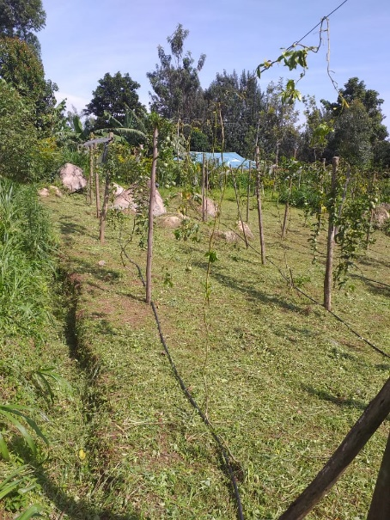
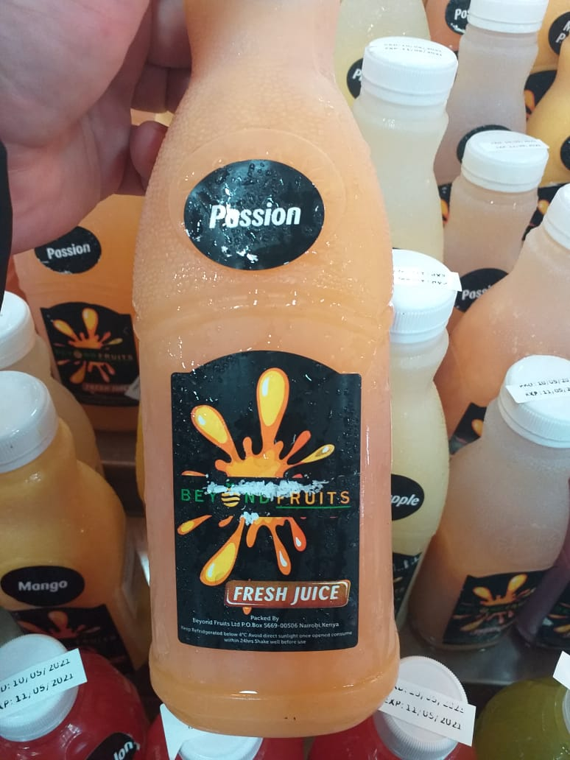
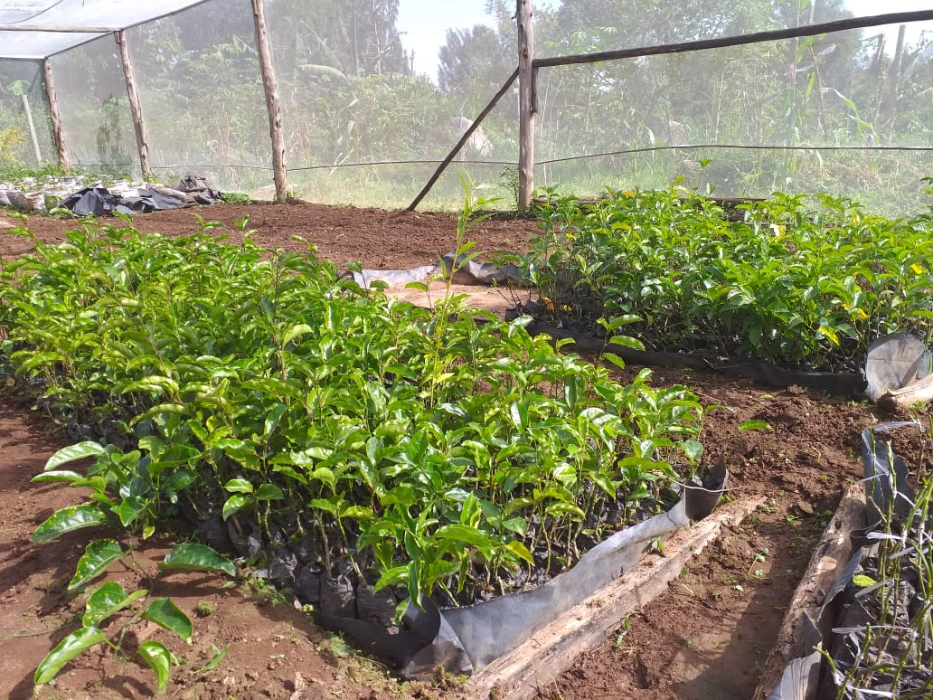
Unlocking jobs for women and youth in the passionfruit value chain in West Kenya
Support women and youth farmers with training, extension and linkages to traders and processors
Develop nurseries with existing training institutions to produce certified planting material
Support traders and processors to increase capacity utilisation through contract farming
Business models in the Passionfruit Value Chain in West Kenya are proposed with specific private partners in mind. Key contacts for each model are listed at the end of the presentation.
An integrated approach supporting business models in nurseries, training, primary production and marketing

Slide 16

No to passionfruit with vegetable intercropping
Intercropping of passionfruit is not recommended by any of the experts interviewed:
  Shared pests like thrips, aphids and blight increase disease pressure
  Increased complexity and expense in management
  Pesticide residues present a risk for exports and for vegetable consumers
  However, it is likely that small-scale farmers will intercrop to maximise land use. In this case the only option is sweet potatoes which is not known to share pests with passionfruit
  Better opportunities for linkages between vegetables and passionfruit are at the packhouse from which vegetables and passionfruit are distributed to the same local, national and export markets.
  Bee Keeping is recommended in passionfruit orchards for pollination and as a low investment income diversification strategy.

Slide 17
Recommended business models in the Passionfruit Value Chain
 | Passionfruit Value Chain Business Ranking Based on Employment Opportunity and Chances for Successful Implementation
No | Business Case | Required Investment | Number of jobs business model | Type of Jobs | Number of potential businesses | Number of potential businesses | Potential for successful Implementation
Primary Production
1 | Nursery with training and market linkages | € 2,000 | Owner and 4 Staff | Full-time |  | 10 | High
2 | Small-scale passionfruit farmers with contract to supply off-takers | € 400 (0,125 acre) | Owner 2 Staff | Full-time |  | 10,000 | High
3 | Extension services and agricultural support with market linkages | € 155 (per farmer) | 20 FTE | Full-time |  | 5 | High
Trading and distribution
4 | Local market and export packhouse with contract farming and extension | > € 50,000 | <20 Women/youth | Seasonal |  | 5 | Medium
Processing
5 | Artisanal juice and pulp processors for local market | >€ 15,200 | 10 | Full-time |  | 10 | Medium
6. | Passionfruit pulp processor for export to international juice companies | >€ 100,000 | 25 | Full-time |  | 1 | Medium

Slide 18
Business Model 1: Professional nurseries offering planting material, training and
market linkages to youth and women passionfruit farmers
Product or Service
Employment Impact
Direct FTE (150)
Manager and 4 Staff in full time employment
Potential for 1 nursery per sub-county (30 businesses)
Indirect FTE (10,000)
2,000 Youth and women passion fruit farmers with 1/8 to ¼ acre per county in 5 counties
100 Women in collection centres and packhouses
Impact on other VC’s:
Seedlings for mango, avocado, macadamia and other fruit
Small nurseries with insect proof tunnels in each sub-county
Nursery staff require training in production and grafting of disease-free seedlings
Supply grafted seedlings to passionfruit farmers
Offers training in orchard establishment and passionfruit farming
Training and seedlings co-financed by off-takers in exchange for contracted supply
Other fruit tree and vegetable seedlings can be offered
Market Entry Difficulty
Entry Point
Define potential partners
Support needed:
  Training in nursery management and production
  Investments in structures, equipment and irrigation
  Training for passionfruit farmers
  Access to finance for nursery/ orchard establishment)
Entry Barriers
Low skill of local nurseries and passionfruit farmers
Shortage and high cost of certified yellow passionfruit seed
Market access for small-scale passionfruit farmers
Limited access to land for women and youth farmers
Access to investment finance is difficult for women and youth
Lands for passionfruit need to be tested for Fusarium and Woodiness Disease

Slide 19
Business Model 2: Small-scale Passionfruit Farm
Product or Service
Employment Impact
Direct FTE: Project should target 2000 farmers
Longer term potential of 2000 per county (10 000)
Indirect FTE 100 Women in collection centres and packhouses
50 Artisanal juice makers
KSH 50 million for Boda Boda transporters
Juice industry in Uganda
10 Nurseries 50 FTE
Small-scale passionfruit orchards of 1/8 acre (scalable)
Produce passionfruit for sale to traders and processors
Establishment costs are KES 25,000 for 1/8 acre or €200
Costs of training and extension KES 22,000-30,000 (€ 200-250)
Break even is in 12 months.
Net income per cycle per acre (if farmed well) is KES 1-1,5 million (€ 7,500-10,000)
Entry Point
Market Entry Difficulty
Define potential partners:
Support needed:
  Training in passionfruit production
  Soil analysis and agronomic support
  Linkages to traders and processors
  Access to finance and co-finance for training and start-up costs
  Access to professional nurseries
  Irrigation
Entry Barriers
High skill level required for successful passionfruit cultivation
High training and start-up costs
Access to land
Access to planting material

Slide 20
Business Model 3: Extension service to new passionfruit farmers
Product or Service
Employment Impact
Direct FTE:
50 FTE in agronomy, training and extension
Project should target 2000 farmers
Longer term potential of at least 2000 per county (10 000)
Indirect FTE
100 Women in collection centres and packhouses
50 Artisanal juice makers
KSH 50 million in revenue for boda boda transporters
Juice industry in Uganda
10 Nurseries with 50 FTE
Company provides extension and training to new passionfruit farmers. Client farmers are introduced at pre-establishment trainings. Services provided are:
  Soil analysis and site survey
  Training and support in orchard establishment
  Orchard management training
  Traceability and food safety training
  Linkages to off-takers
Market Entry Difficulty
Entry Point
Define potential partners
Support needed:
  Coordination of Extension Service Provider with Youth and Womens’ groups, nurseries and offtakers
  Agri-business training to farmers
  Co-finance of farmer training and establishment costs
Entry Barriers
High skill level required for successful passionfruit cultivation
High training and start-up costs for passionfruit
8-month period before income and 2-year repayment period
Access to land
Access to planting material

Slide 21
Business Model 5: Packhouse with contract farming and GAP support to farmers
Product or service
Employment Impact
Direct FTE:
50 FTE in packhouse
5 FTE In agronomy and training
Indirect FTE
50 Artisanal juice makers
KSH 50 million for Boda Boda transporters
Juice industry in Uganda
10 Nurseries with 50 FTE
Company packs fruit and vegetables in a HACCP compliant facility for local, export and processing markets.
Supply contracts with extension support to farmers
Collection centres in production areas
Central sorting and packhouse for: Ugandan juice industry, local and export fresh market, HoReCa, artisanal juice, Nairobi and Mombasa markets and pulp export
Market Entry Difficulty
Entry Point
Define potential partners:
Support needed:
  Coordination of packhouses with extension service providers, youth and womens’ groups
  Co-finance of farmer training and establishment costs
  Access to working capital
Entry Barriers
Lack of working capital to buy fresh produce

Slide 22
Business Model 6: Artisanal juice company
Product or service
Employment Impact
Direct FTE:
10 FTE in juice production per formal company
Space for at least 10 businesses
100 FTE for individual juice makers
Indirect FTE 100 Women in collection centres and packhouses
Market access for 2 000 passionfruit farmers
KSH 50 million for Boda Boda transporters
Job creation in other fruit VC’s including citrus, pineapple and mango
Artisanal juice makers buy 2nd and 3rd grade fruit from packhouses
Fresh juice is sold to HoReCa, retailers and offices in Kenya
Individual juice makers sell on street direct to public
Frozen juice and pulp can be transported to Nairobi and Mombasa for sale to HorReCa or pulp-for-export
Market Entry Difficulty
Entry Point
Define potential partners:
Support needed:
  Coordination with packhouses and with youth and womens’ groups to source fruit
  Access to working capital
Entry Barriers
Competition for passionfruit from Uganda
Lack of working capital to buy fruit
Limited premium markets for freshly squeezed juices

Slide 23
Business Model 7: Pulp Export Company
Product or service
Employment Impact
Direct FTE:
50 FTE in pulp production
Indirect FTE
Buys pulp from 10 juice companies
Market for 36,500 tons per year of 2nd and 3rd grade passionfruit
Absorb production from at least 1600 acres of passionfruit
Pulp for export in asceptic or frozen drums
Buys frozen pulp from juice makers in Kenya
Makes pulp from passionfruit sourced from traders in Kenya
Exports pulp to global juice packers.
Processes minimum of 50 tons of passionfruit pulp per week
Market Entry Difficulty
Entry Point
Define potential partners:
Support needed:
  Coordination with juice makers
  Coordination with packhouses and with youth and womens’ groups to source fruit
  EU Market access
Entry Barriers
Competition for passionfruit from Uganda
Lack of working capital to buy fruit
Competes on global pulp market with developed origins such as Brazil and South Africa

Slide 24
Conclusion: Final Ranking Of Business Models.
Product or Service
Rank | Business model | Direct FTE | Indirect FTE | Complexity | Impact on other sector actors
1 | Small-scale passionfruit farming | 2 000 | 250 | Medium | High
2 | Extension service with market linkages | 100 | 2 000 | Low | High
3 | Nursery with training and market linkages | 50 | 2 000 | Medium | High
4 | Packhouse with contract farming and GAP support to farmers | 150 | 2000 | Medium | High
5 | Artisanal Juice Company | 100 | 2000 | Medium | High
6 | Pulp Exporter | 50 | 2000 | High | High

Slide 25
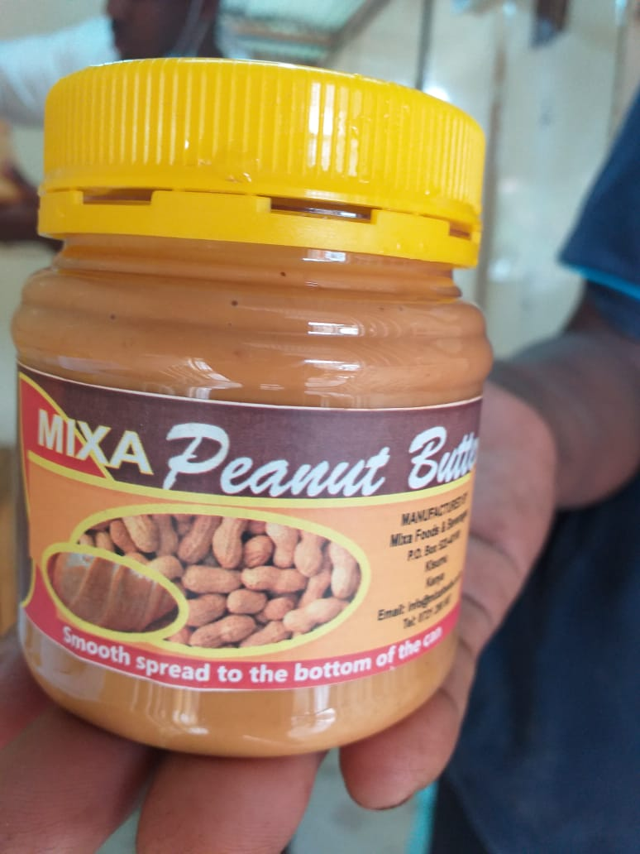
Kenya
Business Model Selection:
Groundnut Value Chain

Slide 26

Issues and Opportunities in Groundnuts
Issues
Groundnuts in West Kenya are grown from recycled seed
No inputs or GAP are used in groundnut production causing low yields
No market linkages: Groundnuts are usually sold off farm, inshell and undried
Farmers store groundnuts to achieve off-season prices, but are often left with unsold stock or sell at a loss
Groundnuts are not part of the West Kenyan staple diet as in Uganda and other African countries
Groundnuts from Tanzania and Uganda are delivered shelled and dried, cheaper than Kenyan groundnuts
There are 2 main varieties known as red and white groundnuts.
The red is most common in Kenya although it produces lower yields <300-800 kg/acre compared to 1-2 000kg/ acre for white
Opportunities
Groundnuts are grown as a relay crop by maize farmers who have a short second rainy season that does not allow for a second maize crop in the Low Midlands
Groundnuts offer an excellent short cycle cash crop for quick revenues
Farmers know that groundnuts are very profitable
Groundnuts present low investment opportunities for artisanal processors
Kenyans traditionally use groundnut paste as a sandwich spread, but it is now being adopted in sauces in traditional dishes.
Groundnuts as a snack are not well known in Kenya
Groundnuts could be exported to processors in other countries with a different production season, such as Malawi
Challenge 2: Processing Equipment
Modern processing equipment is essential
No professional manufacturers
No professional importers & suppliers
No professional maintenance services
3 Key Ingredients for success:
Farmer training, planting material and market linkages

Slide 27
Recommended business models in the Groundnut Value Chain
 | Groundnut Value Chain Business Ranking Based on Employment Opportunity and Chances for Successful Implementation
No | Business Case | Required Investment | Number of jobs per business model | Type of Jobs | Number of potential businesses | Number of potential businesses | Potential for successful Implementation
Primary Production
1 | Groundnut farming as a relay crop for maize in Low Midland areas | Investment in training € 100 per farmer | Owner and hired labour | Seasonal |  | 10,000 | High
2 | Extension services and agricultural support with market linkages for women’s groups | Investment in training € 100 per farmer | 10 trainers | Temporary |  | 2-3 | High
Processing
4 | Small-scale peanut butter processing | > € 2,150 | 1 FTE | Full-time |  | 100 | High
3 | Medium-scale peanut butter processing | €19,000 | 100 FTE | Full-time |  | 2-3 | Medium
Other possible models not proposed
5 | Groundnut roasting for the snack market | >€ 100 | 1 | Full-time |  | 1000 | Innovation and market development
6. | Groundnut export to processors in Malawi | >€ 25,000 | 10 | Seasonal |  | 1 | High current price of Kenyan groundnuts

Slide 28
Business Model 1: Groundnut farming as a relay crop for maize
Product or service
Employment Impact
Direct FTE:
> 10,000 maize farmers in Low Midland areas (5 months per year)
>10,000 part time jobs in weeding and harvest
Indirect FTE
Boda boda transporters to aggregation centres and off-takers
Artisanal and medium-scale peanut butter makers
Produce groundnuts as a cash crop during short rainy season from August to December
Market groundnuts through an association
Market Entry Difficulty
Entry Point
Define potential partners
Support needed:
  Coordination with association
  Access to high yielding disease free seed (white variety)
  Training in GAP and post harvest handling
Entry Barriers
Competition with cheaper imports from Tanzania and Uganda
Limited market for groundnut and groundnut products in Kenya
Farmers grow maize whenever possible and intercrop largely with green beans

Slide 29
Business Model 2: Extension services with market linkages to women’s groups
Product or service
Employment Impact
Direct FTE:
10 FTE in training and coordination
Indirect FTE
> 10,000 opportunities in groundnut farming
> 10,000 part time jobs in weeding and harvesting
Jobs in aggregation
GAP Training to groundnut farmers
Training in post harvest handling
Sale of certified seed to farmers
Linkages to off-takers
Market Entry Difficulty
Entry Point
Potential partners:
Support needed:
  Coordination of women’s groups and association
  Training of groundnut farmers
  Access certified groundnut seeds
  Market linkages to major off-takers
Entry Barriers
Low scale and organization of groundnut sector in Kenya
Low consumption of groundnuts
Low scale and development of groundnut processing (oil and animal feed)

Slide 30
Business Model 3: Small-scale Peanut Butter Processor
Product or Service
Employment Impact
Direct FTE:
1 FTE per business for women entrepreneurs
Possibility for more than 100 businesses
Sales agents (students)
Indirect FTE
Market for groundnut farmers
Transporters of groundnuts to processor and peanut butter to Nairobi and local customers
Buys groundnuts on the local market
Dries nuts on racks
Roasts and mills
20kg of groundnuts 17,6 kg of peanut butter or 22 800g jars
Peanut butter is sold door to door, social media and online through students in Nairobi
Market Entry Difficulty
Entry Point
Define potential partners
Support needed:
  Businesses require KES 270,000 (€ 2,052) in equipment
  KES 11,000 (€ 85) in working capital to buy groundnuts, charcoal and packaging material
  Business skills training
  Market linkages
Entry Barriers
Low scale and organization of groundnut sector in Kenya
Low consumption of groundnuts
Larger competitors are cheaper in formal retail

Slide 31
Business Model 4: Medium Sized Peanut Butter Processor
Product or service
Employment Impact
Direct FTE:
100 FTE women and youth in peanut butter production
Indirect FTE
> 1,200 groundnut farmers required for supply
Buys groundnuts from local farmers
Manufactures peanut butter for sale to HoReCa, retail and direct to consumers in West Kenya
Sells 200 tons of peanut butter per year
Would like to expand to 50 tons per month
This requires drying shelling and storage facilities
Market Entry Difficulty
Entry Point
Potential partners:
  Sweet Nut Butter
Support needed:
  Access to KES 2,000,000 for investments (€ 15,200)
  Access to KES 500,000 working capital (€ 3,800)
  Market access
  Assistance obtaining KEBS certification to access formal retail
Entry Barriers
Low scale and organization of groundnut sector in West Kenya
Low consumption of groundnuts
Larger competitors are cheaper in formal retail

Slide 32
Conclusion: Final Ranking Of Business Models.
Product or Service
Rank | Business model | Direct FTE | Indirect FTE | Complexity | Impact on other sector actors
1 | Groundnut farming as a relay crop for maize | 10 000 | 200 | Low | Medium
2 | Extension services with market linkages to women’s groups | 10 | 10 000 | Low | High
3 | Small-scale Peanut Butter Processor | 100 | 2 000 | Medium | High
4 | Medium-scale Peanut Butter Processor | 100 | 2 000 | High | High

Slide 33
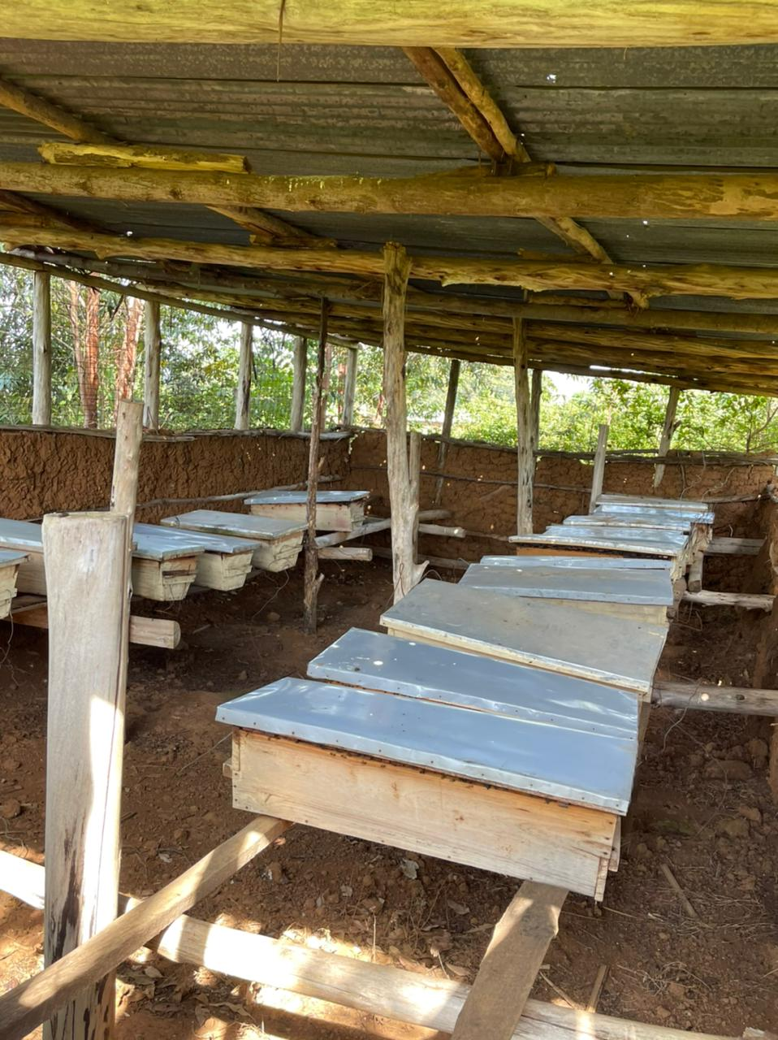
Kenya
Business Model Selection:
Apiculture Value Chain

Slide 34

Issues and Opportunities in Apiculture
Issues
Bees presents a risk to humans and livestock in peri-urban areas
Bees can hinder orchard maintenance
Bees are very susceptible to herbicides such as glyphosate and pesticides as used for aphid control
There is a fire risk associated with beekeeping in forested areas
Hives are vulnerable to honey theft
Beekeeping as a stand-alone business requires keeping hives spread over a large area involving transport costs and negotiation with landowners
Opportunities
Very small investment cost for a single hive (€ 60)
No production costs
Bee pollination of fruit-crops increases yields
Ready markets exist for honey
Minimum scale is 1 hive
Unwanted swarms can be captured and removed as a service to households.
Challenge 2: Processing Equipment
Modern processing equipment is essential
No professional manufacturers
No professional importers & suppliers
No professional maintenance services
Business Case | Required Investment | Number of jobs per business model | Type of Jobs | Number of potential businesses | Potential for successful Implementation
Beekeeping | €100 | 1 | Part-time | Unlimited | High
3 Key Ingredients for success:
Farmer training, planting material and market linkages

Slide 35
Business Model 1: Beekeeping in Orchards and Forest Areas
Product or service
Employment Impact
Direct FTE:
Income diversification for 2000 passionfruit farmers (1 FTE per farm)
Space for at least 10 businesses providing beekeeping as a service to farmers
Number of apiculture businesses is practically unlimited
Indirect FTE
Transport and sale of honey
Small-scale fruit farm with 1 or 2 beehives on farm
Or in forested areas and plantations
Each hive can produce 30 kg of honey per year
An abundance of blue gum in the area provides the bulk of the honey
Bees pollinate passionfruit and other fruit boosting yield
Honey is sold at KES 800/litre to hotels retailers and consumers
Market Entry Difficulty
Entry Point
Define potential partners
Support needed:
  Training in beekeeping
  Investment support in protective clothing and equipment
  Training in organic fruit production techniques
Entry Barriers
High use of pesticides in passionfruit production
Risk of bee attacks on humans and domestic animals
Investment costs of € 100 in hive and protective clothing for start-ups

