Slide 1
Malawi Value Chain Study
Value Chain Fieldwork Feb 2020
1

Slide 2
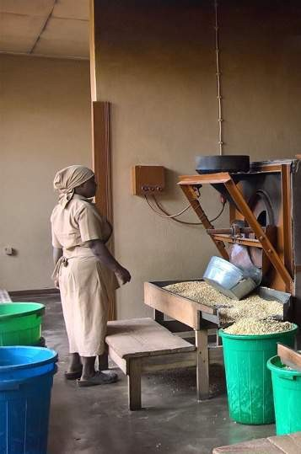
Goals, Methodology
3-6
Green light Chains
7-52
Contents
Yellow light Chains
53-65
Red light Chains
66-81
Conclusions
82-87

Slide 3
Method – Project Overview
QUICK SCAN STEP
VALUE CHAIN STEP
BUSINESS CASE STEP
Business Case Fieldwork ▸Fieldwork to gather final data for business cases ▸Innovation Review – circular economy , tech transfersetc
Business Case Modelling ▸Input data in business models ▸Verify Data (clean-up fieldwork)
Business Case Brief Development ▸Develop & Visualize Business Case Briefs
Desktop Research
▸Existing Value Chain Studies
▸ Food consumption Studies
▸ Gender & Youth Reports
▸Fact sheets and statistics
▸ Trade Data
Commercial Interviews
▸ Private Sector Fieldwork
▸Knowledge industry Experts
▸Development & Government Experts
Malawi Interviews
Expert Interviews
▸ Malawian Sector Experts
▸ International Sector Experts
(face to face)
▸ Local Farmer, Processors, Retail Market Interviews
Exit Meeting/Value Chain Debrief
We are here
Quick Scan Presentation
Value Chain Brief Development
▸ Develop value chain presentation
Quick Scan Highlights and Recommendations
Complete Scoring Sheet
Agree 5 Value Chains for Next Phase
Quick Scan Meeting

Slide 4
We used the prestudy value chain work as a starting point

Slide 5
The project encompasses the central region and specific districts in the Northern region
5
Mzimba
Key
In scope
Kasungu
Nkhota- kota
Out of scope
Ntshisi
Mchinji
Dowa
Salima
Lilongwe
Interviews were conducted to better understand specific questions that arose

Slide 6
Goals, Methodology
3-6
Green light Chains
7-52
Contents
Yellow light Chains
53-65
Red light Chains
66-81
Conclusions
82-87

Slide 7
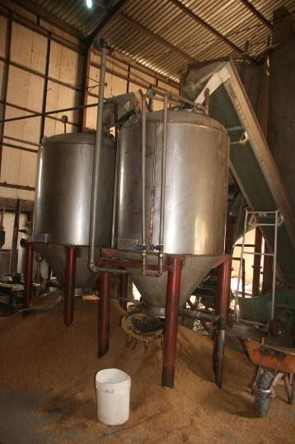
Rice

Slide 8
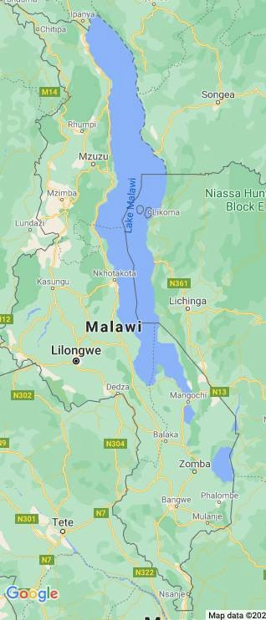
Production occurs within the geographical focus
9

Slide 9
Good Commercial Potential, with strong future prospects
10
Competitive local pricing
Surge in Chinese imports
 |  | Chinese imports/ton
 | FOB price | $470
 | Transport to port | $50
 | Port handling | $10
 | Road transport | $50
 | Import duties | $78 | 15%
 | VAT | $86 | 16,5%
 |  | $744
 | Importer margin | $149 | 20%
 | Final Wholesale price | $893
 | Price per kg | $0,89
 | Local wholesale price | $0.89 – 1.15/kg
Imports of Rice – tons
10000
8000
6000
4000
2000
0
6,586
5,780
2,835
2015
China
2016
2017
2018
Pakistan Mozambique
2019
India
South Africa Other
United States of America
Tanzania, United Republic of
Data sourced from ITC Trade Map
Chinese Rice is the highest price per ton
Price per Ton of Imported Rice- Malawi ($)
1,600
1,400
1,200
1,000
800
600
400
200
0
China
South Africa
Pakistan
India
Italy
United Arab…
United States of…
Mozambique
United Kingdom
Tanzania, United…
Data sourced from ITC Trade Map

Slide 10
Many of the Ingredients for a modern rice sector are present
11
Import Duties/market protections
Irrigation
Modern integrated rice mill
Consumer demand for premium rice
Yields
5-8 ton per ha potential
Transport costs and crossing of land borders
Current rainfed, but near to the lake for irrigation.
Along the lake side: Karonga Nkhotakota
Nkata bay
Salima
Along Lake Chilwa: Zomba
Phalombe (Mulanje)
Machinga
Mailman Holdings
At the moment not active
Rice Milling
Assocation (capacity was 10 MT/day- building a new mill with capacity of 25 MT/day)
Many small mills with a capacity of 2.5 – 3.5 MT output
The Chinese rice premium suggests an affinity for quality rice.
Malawian rice is in demand for it’s flavour in the region and in the EU.
Low yields from rainfed irrigated rice production.
But opportunity to increase rice yields from input
improvements, improved land preparation, seedling transplantations, post harvest handling etc.

Slide 11
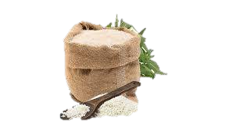
Employment potential along the chain, with good livelihoods effect
12
000 tons
600 tons
3 ton per hour
Sataki rice mill
3400 farmers @ 3.5tons per ha
1x 3 ton per hour rice mill
65% conversion rate
Imports 6000 tons per year
Local substitution 600 tons per year

Slide 12
A few areas of intervention could be addressed by commercial business models
13
Inputs
Processing
Irrigation
Seed
Nurseries and transplanting
Post harvest threshing and winnowing
Milling
Primary Production
Marketing, Sales, Distribution
Extension service (1 per 200 farmers)
Mechanization
Beyond family labour
Aggregation
Transport
Trading

Slide 13
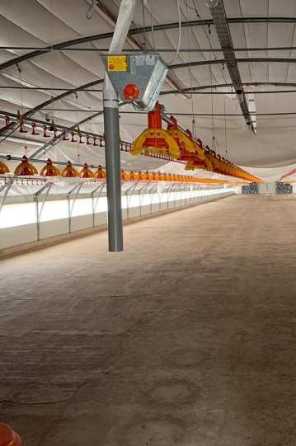
Poultry

Slide 14
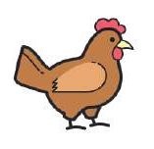
Poultry is widespread, but has 2 larger commercial locations
15

Slide 15
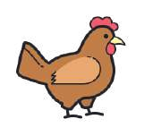
A market of the future with good commercial prospects
16
Lowest Cost of Protein per kg
Growing Consumption per capita
Local market price per kg, MKW
3000
Poultry and egg Consumption Malawi, 2016/2017 vs 2018/2019
2500
2800
30
25
20
15
10
5
0
2300
2400
27.4
27
2000
1500
22
16.9
1000
500
0
1625
2300
2400
Chicken
Eggs
Chi cken Goat Pork Broiler
Data sourced from Market Visit Jan 2021
Beef
Fish (Chmabo Tilapia)
Chi cken Local
Data sourced from Poultry Sector Strategy: Malawi; April 2020
Opportunity to create a more efficient, more competitive production system & improve affordability.
Integrated producer
3.6kg
1.8kg
FCR: 2
Small commercial
4.5kg
1.8kg
FCR: 2.5
Data sourced from interviews Jan 2021

Slide 16
A few ingredients for a modern poultry sector are present
17
In-built barriers to imports
Imported broiler genetics
Tanzania
Angola
Zambia
South Africa
90
Chicken population by type, 2019, millions
80 70 | 83
60 |  |  | 67
50
40
30
20
10
0
8
Broiler Indigenous
Data sourced from Poultry Sector Strategy: Malawi; April 2020
Layers
Black Australorp
Multiple nodes developing along the supply chain
 | # of suppliers
Integrated Poultry Producers (>10 000) | +6
Feed Mills | >5 large feed mills + associated smaller mills
Local Soya, Sunflower cake & Maize & imported pre-mix
Hatcheries
Veterinary Products Suppliers
Data sourced from Poultry Sector Strategy: Malawi; April 2020

Slide 17
Economics of the chain provide good prospects for employment of women & youth
18
000 tons
600 tons
3 ton per hour
Sataki rice mill
+spillover effects Poultry and eggs, feed,
processing, veterinary services, fertilizer
Fast cash rotation every 45 days
High intensity production per ha 2000 per shed
Low barriers to entry & Scalable (to ~2000 chickens, before the troubling middle ground)

Slide 18
Intervention potential through commercial business models
19
Inputs
Processing
Breeding eggs & Expansion of Hatcheries – DOC
Feed mills
Supply for feed mills (soya and maize)
Veterinary services
Circular economy- fertilizer
Abattoir and plucking (formal and informal)
Egg powder processing
Primary Production
Marketing, Sales, Distribution
Extension services
Farming
Aggregation
Transport
Cold storage
Commercial Trading

Slide 19
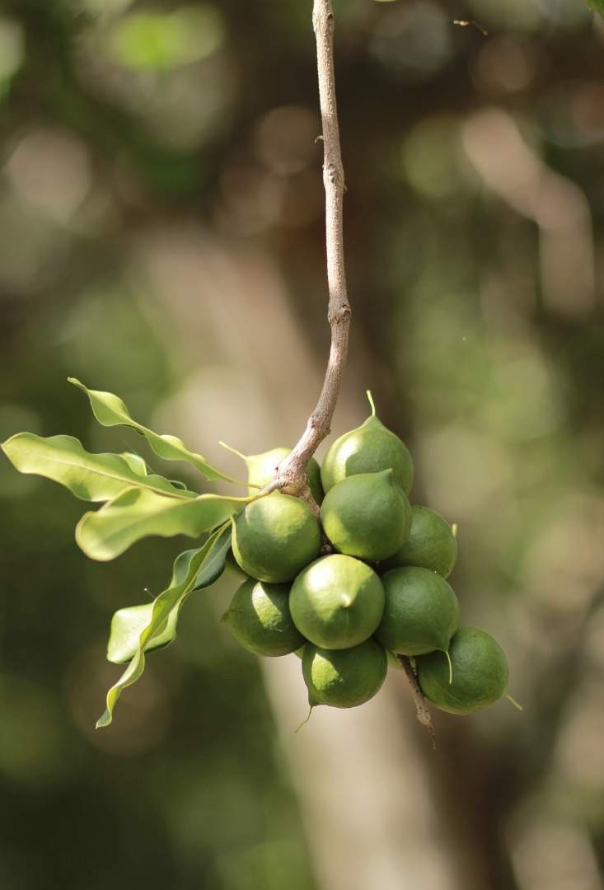
M a c a d a m i a

Slide 20
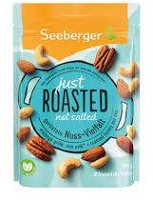
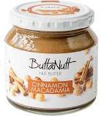
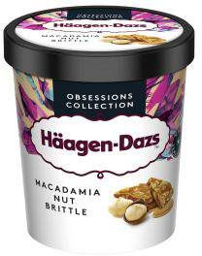
Despite high relative prices, demand for Macadamia nuts is accelerating
21
Macadamia is a dynamic category driven by demand alternate sources of proteins for vegans and followers of new high protein , moderate fat diets
Comparison of The retail price of various nuts
$ per lb*
Macadamia Nuts
Brazil Nuts Hazelnuts Cashew Chestnuts Pistachio Walnuts Almonds Peanuts
0
5 10
Price per lb, $
15
20
25
Sourced from www.nuts.com; 1 March 2021

Slide 21
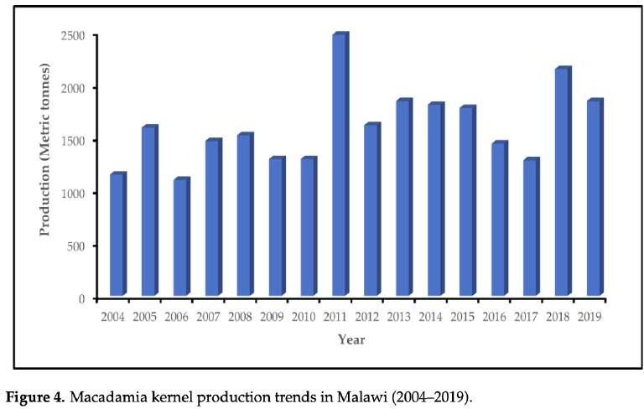
Malawian production has developed over the last 5 years
22
Production volumes have been growing, largely from commercial estates. But smallholder trees are maturing and could double volumes in the coming years
The Production area has expanded beyond the Southern region to parts of the central and Northern Region
New Areas
Commercial
Estates
Mzimba
Lilongwe
Blantyre
Processing happens largely in the South & linkages to major global distributor importers Green & Gold network & Intersnack are developed
An expanding chain developing in maturity, but with scope to advance
 | 7 processors (dehusking and packaging)
 | Major international buyers
 | Small scale producers | Commercial Estates
Farm Size | ≤0.1 ha to ≥4 ha
Yields | ≤100 kg ha
Contribution to total production volumes | 10% of total production volumes | 90% of production volumes

Slide 22
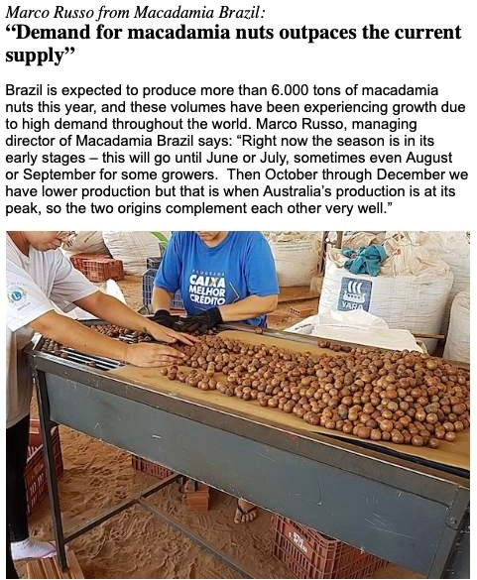
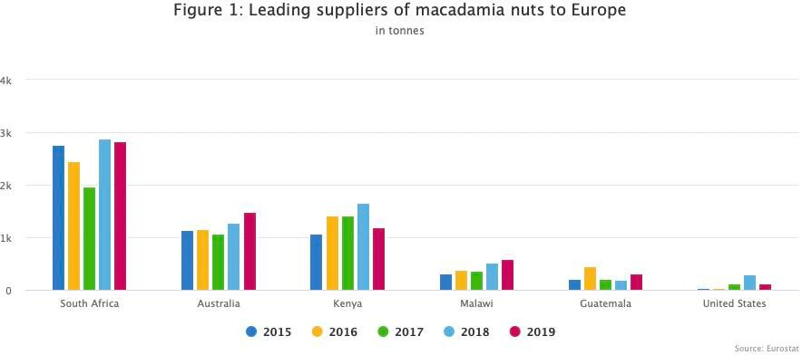
But there’s space to increase supply, especially as it is 1 of 3 origins specified by retailers in Germany
23
Supply can’t keep up, meaning that availability of macadamias is the biggest bottleneck
Supply comes from relatively few countries- with Malawi in the top 7 globally & # 4 to the EU
There are so few producers that when fewer nuts are produced somewhere like South Africa, prices rise. Then demand falls.
CBI Market Researcher,
Macadamia
If you can produce more macadamia nuts, the market can absorb them.
Buyer, Importer EU

Slide 23
Smallholder involvement is being facilitated through outgrower schemes, but more can be done
to tackle the challenges in the chain
24
Quality & Availability of seedlings
Extension services
Pest Control
Currently expensive and not affordable to small scale producers
Provided in existing outgrower
programs
Maintaining trees after planting for 5 years is required to ensure good yields
But this specialist knowledge needs to be taught
These skills are in short supply
Pest outbreaks can cause a 100% loss
Cultivar development suited to Malawi
Processing closer to producers- especially in the North
Yields are highly variable from district to district
Average yields are below the potential yields of 1200kg per ha (current small scalers < 100kg per
ha)
Small scalers sometimes transport nuts >600km, which is costly
On farm or cooperative owned
dehusking machines could improve access and reduce logistics costs

Slide 24
This developing chain, being a high value niche and the approaching commercial stage outgrower
schemes are creating opportunities for wide variety of services
25
Inputs
Processing
Nurseries
Logistics
Agronomists
Certification experts
Food technologists
Factory Managers
Quality managers
Certification experts
Suppliers of processing and farming equipment
Maintenance of equipment
Pest Control services
Sales and marketing
Production planners
Training and technical skills
Primary Production
Extension services
Farming
Orchard maintenance services
Harvesting teams
Marketing, Sales, Distribution
Aggregation
Transport
Commercial Trading
Regional trade and exports

Slide 25
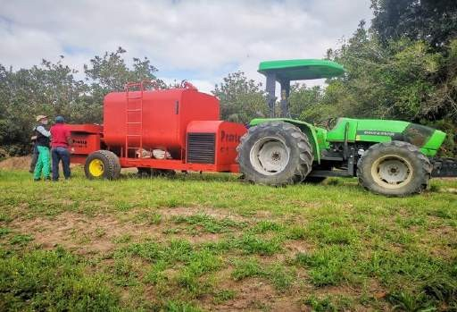
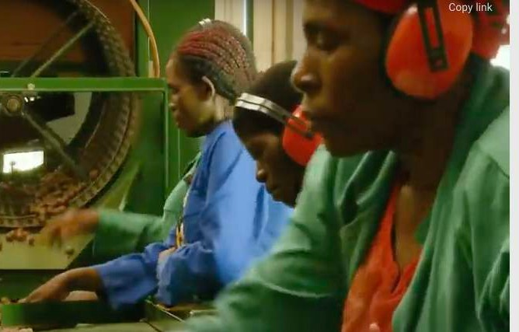
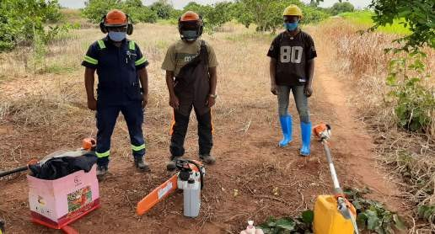
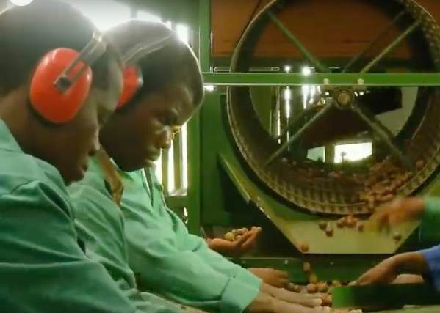
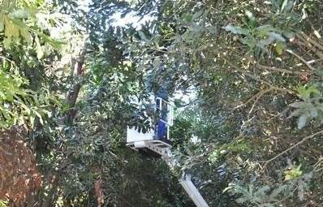
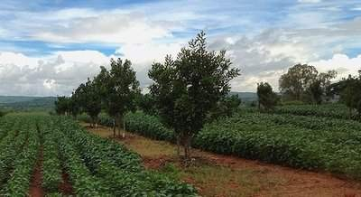
The character of these jobs means that there is a good likelihood that they will be more inclusive & they are26
very future forward
Good fit with youth interest in mobile jobs & tech savvy opportunities
Processing jobs in factories & on estates - typically taken up by youth and women
Modular investments are possible for orchard services
Mobile dehusking machine in South Africa
Existing farm hubs and outgrower models creates natural offtakers. With more producer clubs coming online in 2021/2022 (DAPPS)
Picker allowing top of tree to be picked

Slide 26
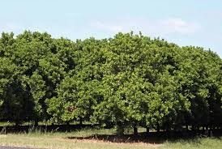
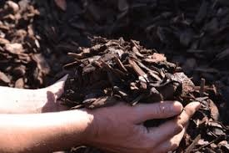
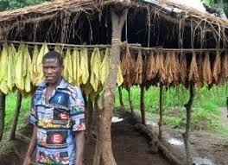
There are a few halo effects from expanding support for macadamia
27
Reforestation
Circular Economy
Tobacco Jobs in central region
Trees provide positive benefits for the environment, carbon sinks and even for combatting climate change
Husks can be used to create mulch for the farm, for sale or for biofuel burners in factories
Macadamia can provide alternate livelihoods for the skilled tobacco farmers in the central region who are having to shift focus as tobacco demand falls

Slide 27
Access to land in the South is problematic, but this can be alleviated by continuing expansion in the central
and northern regions
28
New Areas
Commercial Estates
Mzimba
The existing GiZ funded projects means that supporting these chains is a natural extension of existing capabilities, focus and know-how.
Lilongwe
Blantyre

Slide 28
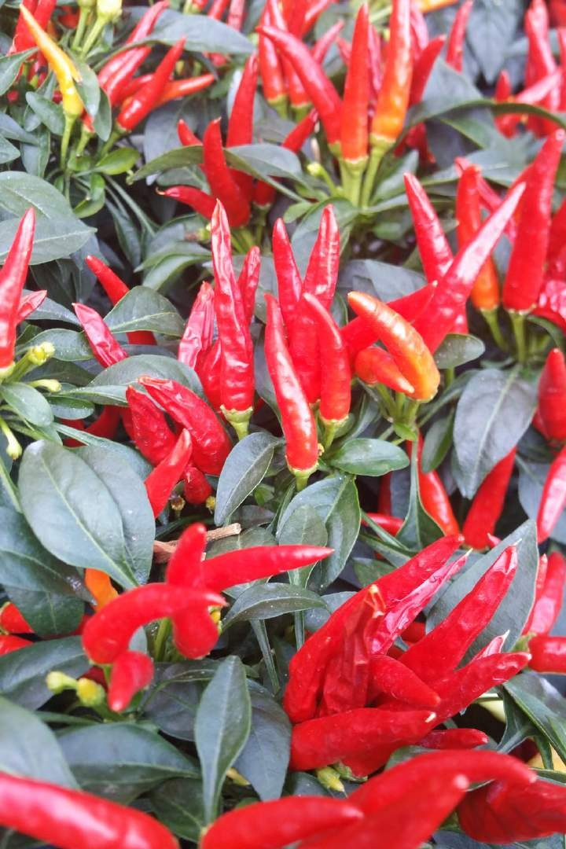
Chilli

Slide 29
30

Slide 30
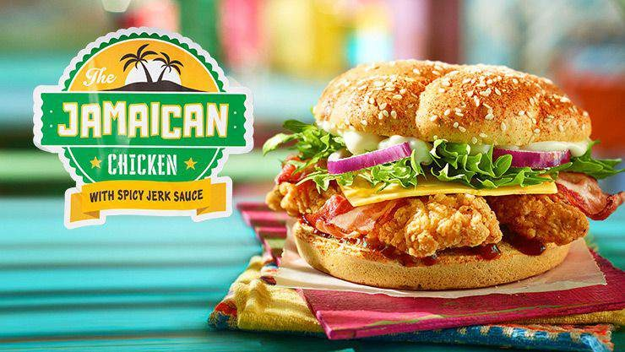
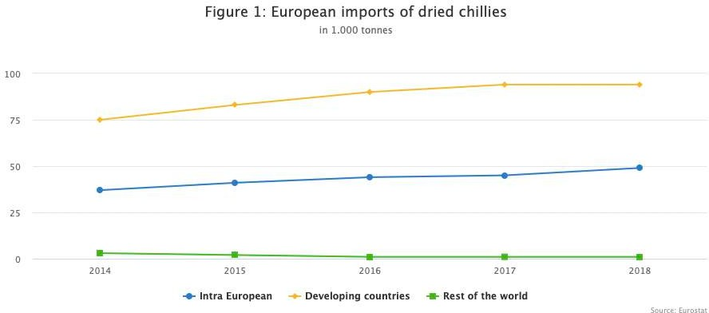
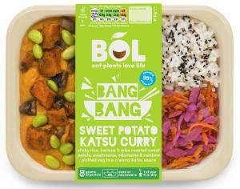
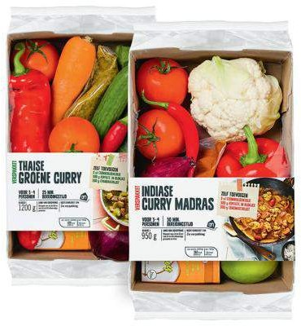
The popularity of ethnic cuisines is driving demand for chilli globally
31
Ethnic cuisine is driving growth in the global demand for chillies
EU Imports have grown consistently year on year throughout the 2000s
Smallholder farmers are active in the chain, but production has been developing in more developed commercial estates for exports and processing

Slide 31
Despite surging demand locally and globally, Malawian chilli production and exports are in decline in
recent years, off an already small base
33
Malawian Exports of Chillies, Euro
Production of Chillies in Malawi (tons)
2500
1800
1600
1400
1200
1000
800
600
400
200
0
2000
1500
1083
1000
500
0
2015
2016
2017
Production (tons)
2018
2019
2017
2018
South Africa
2019
Europe
Other
'no-one can find chilies. Local processors are always looking, but nothing”

Slide 32
Malawian chillies have a few issues that are preventing a competitive product on the world market
34
Hesitancy to offer Organic certified product
This is seen as a proxy for low pesticide residues and traceablity
Required by most EU importers
But this is difficult and costly for farmers
Poorly organised chain
Malawian aggregators have often not met the quality and order volumes reliably
Indian producers are very organized and get support
from spice processors who are nearby in Kochi
Logistics costs
Transport cost from Malawi are higher due to the fact that they first have to transport the product to a habour outside the country.
Product must first be sent to Dar Es Salaam or Beira
Price of Birds Eye Chilli Malawi vs Prices offered by the EU
 | EU | Malawi
Price (Euro) | $3.50-$4.50 FOB Beira | $2.56-3.20

Slide 33
Production is being incorporated into outgrower programs linked to Macadamia as well as assorted
donor projects.
35
Increased chances of Success
Smoother organisation between growers and the market
Opportunities for integrated packing facilities
Agronomic support and improved inputs for better yields
Potential for pre-financing of inputs and services

Slide 34
This developing chain, being a high value niche and the approaching commercial stage outgrower
schemes are creating opportunities for wide variety of services
36
Inputs
Processing
Nurseries
Logistics
Agronomists
Certification experts
Factory Managers
Quality managers
Certification experts
Suppliers of processing and farming equipment
Maintenance of equipment
Pest Control services
Sales and marketing
Training and technical skills
Primary Production
Extension services
Farming
Harvesting teams
Marketing, Sales, Distribution
Aggregation
Transport
Commercial Trading
Regional trade and exports

Slide 35
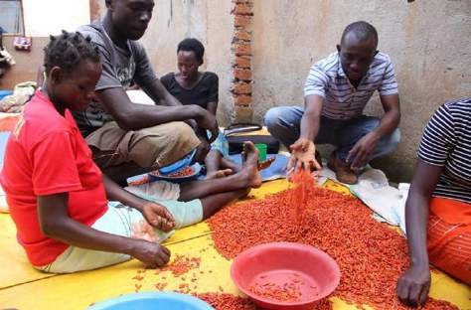
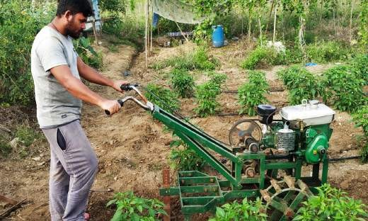
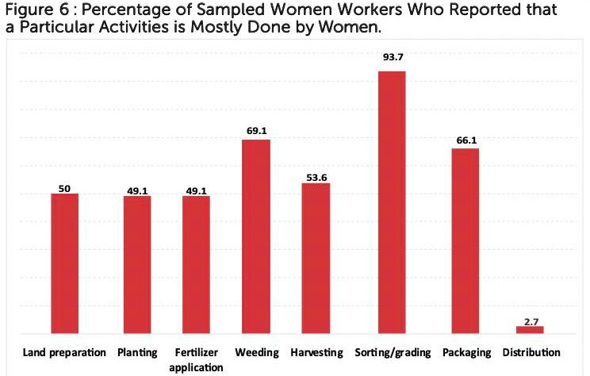
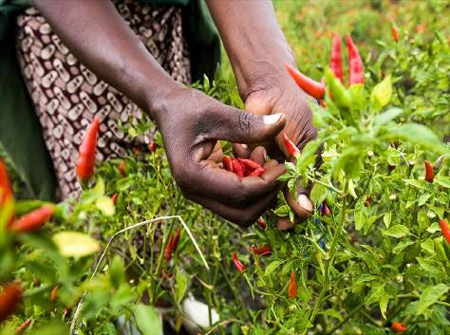
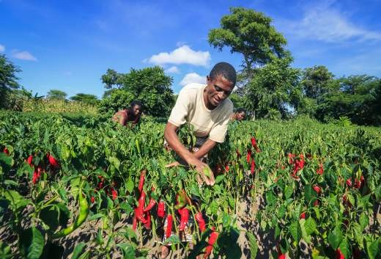
The chillie value chain offers good prospects jobs & especially for women and youth
37
Women are actively involved along the chain, but especially sorting and grading
Sorting & grading jobs in factories & on estates - typically taken up by youth and women
Modular investments are possible for various services such as land preparation
Harvesting requires large numbers of seasonal workers
Fast return of investment for new chilli farmers in outgrower models
Sourced from HIVOS Baseline of women in the Chillie Value Chain- Malawi, 2019

Slide 36
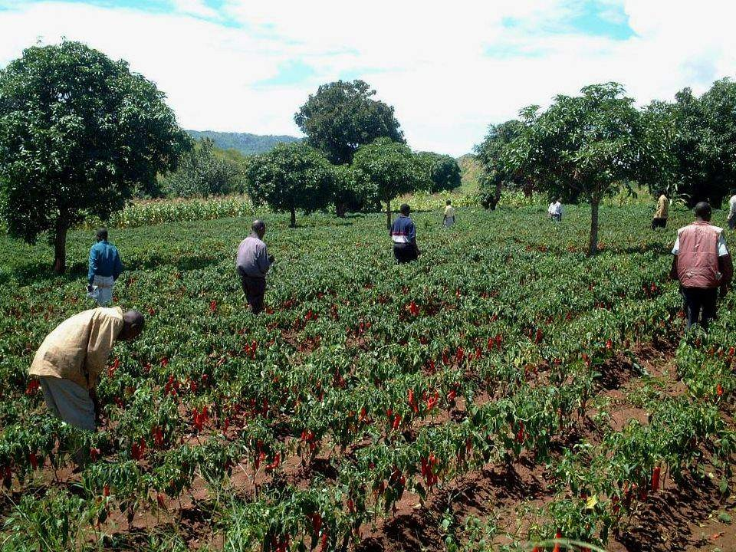
There are a few positive halo effects that can be achieved y supporting activities in this chain
38
Good for the earth & workers
Access to the EU depends on organic certification and low pesticide residues, which is good for the environment and health & safety of growers
Good working conditions and wage equality on estates
These organised programs supported by donor agencies has ensured fair working conditions and closed gender disparities.

Slide 37
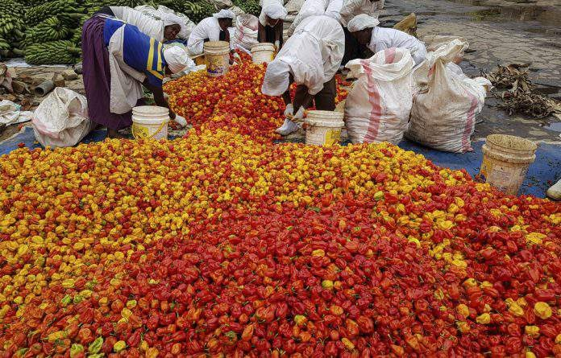
There are some health and safety risks & some instances of wage issues that will need to be
managed as this chain expands
39
Fumes from grading require professional management of packing facilities
Estates currently manage this well. But small scale farms will need focus to ensure that this is an industry norm.
Estates pay above minimum wage, but others do not
Small holder farms have been known to pay below the official rural minimum wage

Slide 38
Greenlight
But out of scope as these are included in
other programs and centres

Slide 39
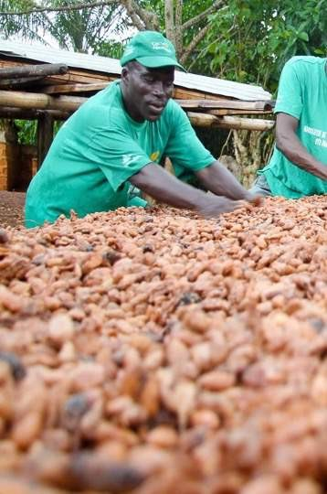
Groundnuts

Slide 40
Groundnuts have widespread production in the Central region
42

Slide 41
Good commercial potential in the region, with demand in the EU if aflatoxin can be controlled
43
Growth driven by exports to the Region- Kenya & Tanzania
$ Price per ton Malawi vs Major Exporting Countries
60,000
50,000
48 000 tons
1400
1200
40,000
18,586
1000
800
30,000
22 000 tons
20,000
19 300 tons
600
400
200
0
13 000 tons
21,789
10,000
0
2015 2016
Tanzania, United Republic of
2017
South Africa
2018
Zambia
2019
Other
Kenya
Zimbabwe
China
Botswana
Zimbabwe
Kenya
Angola
Tanzania
Ghana
Indonesia
South Africa
Mozambi que
Zambia
Total Malawi
USA
Bra zi l
Argenti na
Data sourced from ITC Trade Map
Data sourced from ITC Trade Map
Growing Production with good opportunities for productivity increases
Growing Development of the Chain as tobacco producers switch focus
Yields per ha
Large Farms | 7% of production
Small scale farmers | 93% of production
Exporters
Seed multiplication
Processing | Sorting, shelling, roasting *Sept 2021
274876
5
⎯ Pre-irrigation
2015
3.,2
350000
2.2
⎯ Aflasafe, inoculant
2019
1.2
National Average
(good farmers)
0 100000 200000 300000
Data sourced from ITC Trade Map
400000
Data sourced from Interviews, Jan 2021
Data sourced from Reports

Slide 42
Employment potential
44
000 tons
600 tons
3 ton per hour
Sataki rice mill
Labour intensive with good representation of women
Decent revenue per ha, fast return on investment (3 months)
With opportunity for yield improvements
Value Added processing opportunities
Sorting, cleaning, shelling, roasting , grinding etc.

Slide 43
Intervention opportunities through commercial business models
45
Inputs
Processing
Seed development (testing)
Seed Multiplication
Small scale irrigation systems
Aflasafe, herbicides etc provision
Sorting, cleaning
Manufacturing (pastes, peanut butter, RUTF<,snacks, baked goods etc. )
Primary Production
Marketing, Sales, Distribution
Extension services
Farming
Aggregation
Transport
Storage
Commercial Trading (export region & potentially EU)

Slide 44
Revenue Potential per Hectare suggests that groundnuts have a good chance of success
46
 | Revenue per kg MKW | Yield Potential | Revenue per ha MKW | GM
Soy-bean | 180-240 | 2 tons per ha | 0.36-0.48m | TBC
Groundnut | 280-400 | 5 tons per ha | 1,4m | TBC
Irish Potato | 158 | 40 tons per ha | 6,32m | 49%
Rice (Rainfed) |  | 5 tons per ha
Rice (Irrigated) |  | 8 tons per ha
Chicken and Eggs
Tobacco | 1089-1166 (1.4USD-1.5USD) | 1.6tons-2.2tons per ha |  | TBC
Tobacco (Virginia) | 1868 (2.40USD) |  |  | TBC

Slide 45
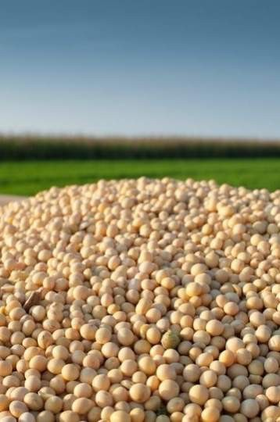
Soya

Slide 46
Soya is grown in many parts of the Central and Southern region
48

Slide 47
Strong commercial potential for export and local opportunities
49
Imports of Oils, Tons
Export volumes of soy cake and beans , tons
80,000
120,000
70,000
50,276
60,000
100,000
18,558
54,044
50,000
80,000
40,000
47,385
35,476
30,000
12,863
60,000
61,209
26,535
20,000
9,388
12,571
15,288
40,000
44,362
10,000
13,272
12,663
13,346
37,953
9,557
0
20,000
20,408
8,161
2015
2016
2017
Margarine
2018
Sunflower oil
2019
11,101
Palm oil
Soy Oil
0
2015
2016
soy bean cake (tons)
2017
2018
2019
Soya bean tons)
Data sourced from ITC Trade Map
Data sourced from ITC Trade Map

Slide 48
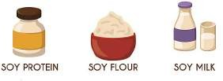
Growing production to satisfy local demand for soya products
50
Production has been increasing
Yield improvements are possible
Production Volumes, tons (FAOSTAT)
2.5
2
1.5
1
0.5
Potential Yield (rainfed)
170000
inoculant, quality seed, GAP etc.
2019
132185
2014
Current National Average
Data sourced from FAOSTAT
Data sourced from Key Reports
A variety of market opportunities
Animal Feed Oils Food Products
133 000 tons | 190 000 tons | Unknown quantity CSB
required for broilers and | imported,
layers per year | $967 per ton
Maize, soy bean, groundnut

Slide 49
Good employment potential, albeit at lower revenue per ha than groundnuts
51
000 tons
600 tons
3 ton per hour
Sataki rice mill
Labour intensive , considered a women’s crop (threshing and winnowing)
Fast return on investment (3 months)
With opportunity for yield improvements
Value Added processing opportunities
Soya cake, oils, animal feed, soya foodstuffs ie milk, chunks, cheese etc.

Slide 50
A variety of business models are possible, with a strong skew to processing
52
Inputs
Processing
Seed development (testing)
Seed Multiplication
Small scale irrigation systems
Aflasafe, herbicides etc provision
Sorting, cleaning
Manufacturing (pastes, peanut butter, snacks, baked goods etc )
Primary Production
Marketing, Sales, Distribution
Extension services
Farming
Aggregation
Transport
Storage
Commercial Trading (export region & potentially EU)

Slide 51
Goals, Methodology
3-6
Green light Chains
7-52
Contents
Yellow light Chains
53-65
Red light Chains
66-81
Conclusions
82-87

Slide 52
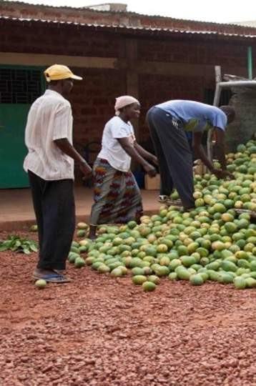
Mango

Slide 53
Mango production extends from Nkhotakota down in to the Southern region
55

Slide 54
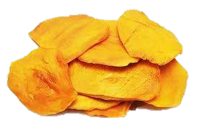
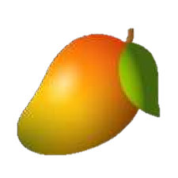
Mango production has been growing for export
56
Mango production has been expanding
Mango exports are a new development
Mango Production Volumes, tons
Fresh Mangoes
2500000
$1400 per ton
Fresh Mango Exports, Q4 2018
2000000
1500000
13%
1000000
5%
500000
55.5 tons
40%
United Arab Emirates India
United Kingdom Kuwait
0
2009
2010 2011
2012
2013
Tons
2015
2016
2017
2018
2019
Indian Winter Alfonso supply
Data sourced from ITC Trade Map
42%
A more commercial model is developing lead by Malawi mangoes
 | Smallholder | Small Commercial <10ha | Commercial Outgrower >10ha
Price MK/ha | 102 | 750 | 750
Gross Margin | 78% | 87% | 87%
Euro | 0.10 | 0.80 | 0.80
Data sourced from Reports- Fee | d the Future | Too expensive for dried mango
Dried Mangoes
25 tons to South Africa Q2 2019
$6880 per ton
325 tons fresh mango
Conversion rate 1:13

Slide 55
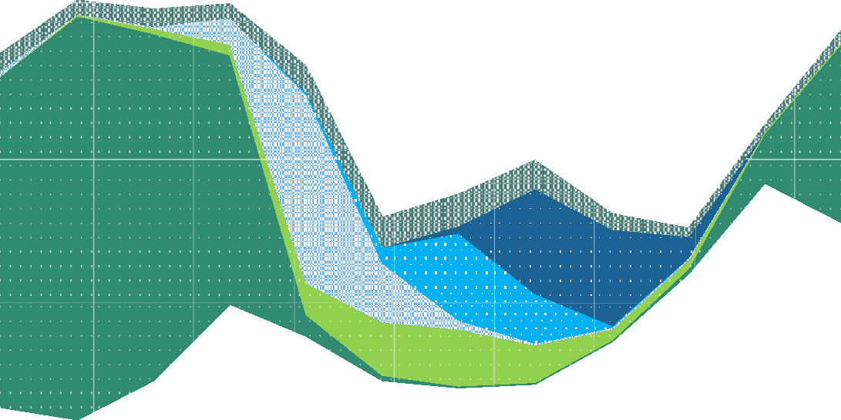
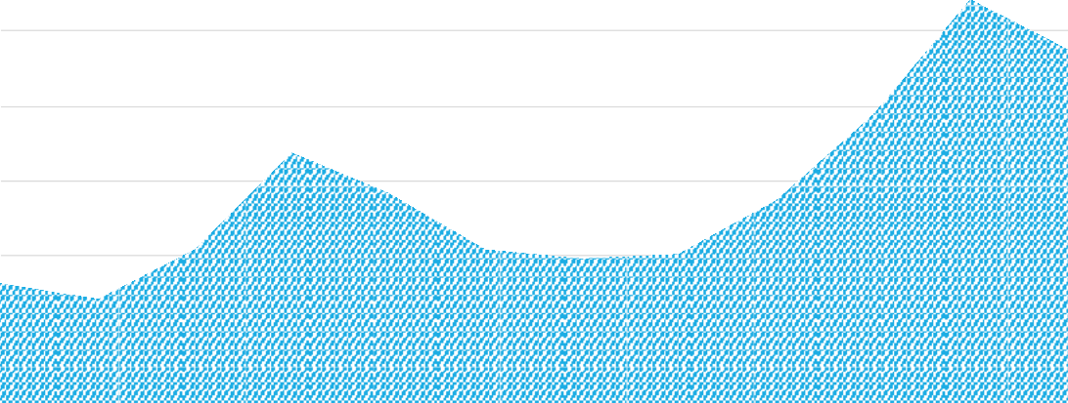
But is there an opportunity for sustained trade?
57
The fresh season in Malawi is during the peak production season for Brazil, and Peru
Very recent dried mango exports to SA have been in Q2 of 2019. Is this end of season top ups?
European Imports by Lead Origins 2019, Euros
 | J | F | M | A | M | J | J | A | O | N | D
Burkina Faso |  |  |  |  | x | x | x | x
South Africa | x | x | x | x |  |  |  |  |  |  | x
Malawi |  |  |  | x
90000
80000
Space for growth
70000
60000
50000
40000
30000
20000
10000
0
Jan
Feb
Brazil
March
Peru
April
May June
Dominican Republic
July
CDI
Aug
Senegal
Sept
Oct
Israel
Nov
Ghana
Dec

Slide 56
Good employment potential, especially for women & Youth in collection, services and
processing
58
>5 years for cash flow positive
000 tons
600 tons
3 ton per hour
Sataki rice mill
Labour intensive , considered a women’s crop (threshing and winnowing)
Services opportunities well suited to youth
Value Added processing opportunities- quality jobs in season

Slide 57
There are opportunities for business models- provided that market access is consistent
59
Inputs
Processing
— Nursery development
Packhouse staff
Drying facilities
Dryer maintenance
Primary Production
Marketing, Sales, Distribution
Extension services
Farming
Maintenance & Spraying Services
Land preparation and harvesting services
Aggregation
Transport/logistics
Cold storage
Export

Slide 58
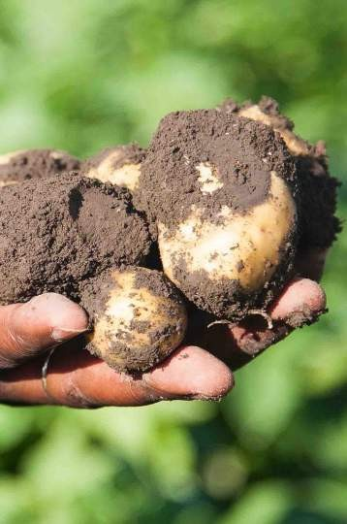
Potato

Slide 59
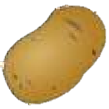
Potatoes are still grown at a small scale in the southern part of the northern region and in the
central region towards the lake
61

Slide 60
There seems to be unmet demand for potatoes
62
Potato production seems stable
Potato Production Volumes Malawi, x 1000 tons
Unmet demand seems to exist in 3 key market segments
Ware Potatoes
5000
4500
4000
3500
3000
2500
2000
1500
1000
500
0
Demand from urban consumers in Lilongwe, Blantyre, and Mzuzu as well as other trading centres
4152
4536
This seems like problematic data, but will need to be checked in field
3428
3674
3613
 |  |  |  |  |  |  |  |  |  | 1024 |  | 1066 |  | 1043 |  | 1227 |  | 1126 |  | 1219
2009 |  | 2010 |  | 2011 |  | 2012 |  | 2013 |  | 2014 |  | 2015 |  | 2016 |  | 2017 |  | 2018 |  | 2019
Fresh Cut Chips
This “service” exists commercially. Typical end markets are restaurants, fast food outlets and hotels.
Data sourced from FAOSTAT
Imports help to close some gaps in demand
Imports of Potatoes, tons
1600
1400
1200
1000
800
600
400
200 0
642
$328/ton
Crisps
773
20 tons per day is required for a local snack factory opening in September.
$527/ton
2015
2016 2017 2018
South Africa Tanzania, United Republic of
2019
Data sourced from ITC Trade Map

Slide 61
Good income is possible along the chain
63
Commercial seed demand offers opportunities for revenue on small land holdings
Yield improvements offer increases to revenues for primary producers
Commercial Seed Demand Estimates tons
 | Farmer | Trader | *Processor
Price (MKW per KG) | 158 | 260 | 659
Margin
Profit % | 49% | 28% | 54%
Excludes industrial crisp producers; Sourced from Analysis of the Value Chain for Root and Tuber Crops in Malawi: The case of Irish Potatoes, Feed the Future, 2018
120000
100000
x9
114000
80000
60000
40000
42000
20000
0
12700
Current Seed Demand
Lowest estimate
Best Case Scenario
Data sourced from Feed the Futures Study, 2019
Yield improvements offer increases to revenues for primary producers
50 tons per ha
40 tons per ha
18 tons per ha
South Africa and Senegal (industrial producers)
Estimated potential
Data sourced from Feed the Futures Study, 2019
X1.6-2.2
Revenue
⎯ With Gap & Seed
⎯ Current Yields
~67 000
farms
Data sourced from Feed the Futures Study, 2019

Slide 62
Potatoes offer some of the most lucrative opportunities, with a good fit for women and youth
64
000 tons
600 tons
Labour intensive, high revenue for ha, low land requirements for a good living.
2 permanent + harvest
(based on Senegal small holder farmers)
Fast return on investment (3 months)
With opportunity for yield
improvements
Value Added processing opportunities
Storage, Cleaning and sorting, Crisps,
Fresh cut fries etc
Scalable business models along the chain

Slide 63
Good employment potential with scalable business models
65
Inputs
Processing
Basic and Breeder Seed development (testing)
Seed Multiplication
Small scale irrigation systems
Sorting, cleaning
Hand Cut Chips
Manufacturing (crisps )
Primary Production
Marketing, Sales, Distribution
Extension services
Farming
Mechanization services
Land preparation and harvesting services
Aggregation
Transport
Storage

Slide 64
Goals, Methodology
Green light Chains
Contents
Yellow light Chains
Red light Chains
Conclusions

Slide 65
Horticulture- Apples, Pears
67
Out of scope
Geographically
Agro-Ecological Constraint
Apples, pears and gapes long periods of cold below <7℃ to flower.
Low Productivity
Outdated orchards
Commercial scale
Not able to achieve minimum volumes for commercially competitive milling of wheat.
Commercial Potential | Employment Potential
Halo Effect | Chance of success

Slide 66
Horticulture- Vegetables
Small commercial markets
For the largest share of the population, you’re competing with subsistence crops and low disposable income.
Urban markets are required to drive commercialization of this chain.
Currently total vegetable imports are
$1,4m.
Even with a quadruple of these import volumes this is still a small opportunity ($5,2m)
Small scale- small employment opportunity
Even at the tripling of this market, it’s
still valued at $5,2m.
This is not a driver of widespread employment.
Similar projects have struggled
Horticulture chain development for low-income local markets is difficult.
You tend to compete with mass produced subsistence crops amongst a population with low disposable income. Or you need an urban or export market that can afford this.
Low organisation of the chain
New routes to market will need to be developed- especially urban
Previous experience has shown that collectors are a critical missing link.
Commercial Potential | Employment Potential
Halo Effect | Chance of success

Slide 67
Fruit Crops- Citrus
These precision, high income per ha, small land requirement jobs are well suited to women and youth.
Small Market Opportunity
Imports to Malawi are generally of Mediterranean fruits and citrus from South Africa
The scale of these imports is small- approximately <$2m in 2019
So the local market - even when quadrupled is small ~$8m
Commercial Potential
Employment Potential
Slow rate of scale up
The rate of scale up of fruit orchards is >5 years.
Nurseries, land clearing and tree
planting will be needed. But the scale up will be slow for local “investors”.
Halo Effect
Chance of success
Competitiveness
Malawian producers would be competing with S Africa- the largest exporter of citrus in the world
Greenfield Investment
The experimental nature of this chain, the long timelines for positive revenues
and the lack of organisation of the value chain all mean that this is a greenfield investment. Access to finance will not be straightforward.
There is only Tangerine in Malawi in Mwaza, This district is out of geographical scope
No Complimentary Policy or Programs
No real examples of large-scale investments or resourcing of projects by development agencies, the state, or the
private sector.

Slide 68
Spices excl chilli
Commodity market price variations
A good global market today
Pricing in spices is very variable
Large scale, entrenched competitors
India dominates the spice trade, alongside Nigeria, China and other Asian countries.
Buyers need real reasons to look elsewhere.
Unlikely Price Competitiveness
Low-cost competition is unlikely in Malawi because of higher freight costs and costs of doing business.
New differentiators add cost and risk
Traceability and low pesticide residues are 2 key drivers of new locations- especially for herbal botanicals. But these must be delivered with very low-price premiums.
New exciting varieties are another reason to introduce new sourcing locations. But these are greenfield projects that are experimental e.g. Thai ginger.
Commercial Potential | Employment Potential
Halo Effect | Chance of success

Slide 69
Coffee
Out of geographic scope
Small scale of production
Commercial Potential | Employment Potential
Halo Effect | Chance of success

Slide 70
Dairy
Small commercial markets
Low national consumption due to low refrigeration rates.
Consumers purchase in small packages.
Powdered milk is the norm, has high
penetration and is ambient stable.
Commercial Potential | Employment Potential
Halo Effect | Chance of success
Agri-ecological suitability
In general, too hot to produce milk in the geographic scope
Yields are significantly lower than in the EU (20l vs 50l)
Barriers to entry are high
Purchase costs for a dairy cow are high
Feed costs are prohibitive for dairy cows- the maintenance ration is very high- even with hybrid cows.
Collection points with new mobile milk collection stations are being
trialed by large dairy suppliers, but these are still new.
Competitiveness vs milk powder imports
Difficult to compete

Slide 71
Hemp, Bamboo, Beekeeping, Baobab
Greenfield investments
Not tested at scale in Malawi
Small Commercial markets
What demand already exists for these products?
Commercial Potential | Employment Potential
Halo Effect | Chance of success

Slide 72
Aquaculture
74
Small commercial markets
Low national consumption due to low refrigeration rates.
Consumers purchase in small packages.
Powdered milk is the norm, has high penetration and is ambient stable.
Commercial Potential | Employment Potential
Halo Effect | Chance of success
Technically Difficult
Precision job in an African context
Africa Projects have struggled across Africa
High operation costs
Risky
Affordablity:
Policy , policy implementation
Speciies
Farmed Tilapia is expensive
Is there sufficient disposable income
Competing with Chinese Tilapia
Not Labour Intensive

Slide 73
Sesame
75
Not Labour Intensive
Limited processing capability
Oil markets are in Asia,
Local markets are too price sensitive
Production at too small a scale
Can you grow Bakery sesame in Malawi
Commercial Potential | Employment Potential
Halo Effect | Chance of success

Slide 74
Forestry
76
Barriers to entry are high
Initial investments are high- land clearing.
Long investment period prior to positive cash flows (5 years for initial revenues, 20 years for mature forests).
Even larger investment required for paper milling.
Large tracts of land
A critical aspect where many forestry plantations fail- which markets will deliver returns in 20 years?
What intermediate markets can be serviced by 5- or 10-year thinnings?
Competition for land
Large tracts of contiguous land is needed, which often creates pressure with indigenous communities
Shy Capital
Poor IRR for forestry Investments have made investors wary of investing.
There are interested investors- but typically
for near shovel ready projects.
The hunt for markets
A critical aspect where many forestry plantations fail- which markets will deliver returns in 20 years?
What intermediate markets can be serviced
by 5- or 10-year thinnings?
Commercial Potential | Employment Potential
Halo Effect | Chance of success

Slide 75
Goats
77
Competition with subsistence economy
Commercial chains would compete with household rearing their own goats.
Environmental pressure
Unchecked goat rearing can denude soils and degrade lands.
Commercial Potential | Employment Potential
Halo Effect | Chance of success
Low consumption market
Competition for land
Goats do roam – in to the fields
Goat meat is an expensive source of
protein.
So, this is rarely eaten by Malawians
Is there sufficient demand amongst urban
wealthy to support commercialization at scale?
Low scale of development
Very rural local markets of the value chain
Experience in Asia:
Goat milk and goats cheese

Slide 76
Wheat
78
Out of Geographic Scope?
Agro-ecological conditions:
Too dry
Optimal yields require
temperatures of 12 ℃ -25 ℃
Competitiveness
Competitors are international mega wheat producers.
Wheat vs Mozambican producers with access to the port
Commercial Potential | Employment Potential
Halo Effect | Chance of success

Slide 77
Sweet Potato & Cassava
79
Small commercial markets
Small commercial market for table Sweet Potato
Greenfield Markets
Sweeteners untested
Commercial Potential | Employment Potential
Halo Effect | Chance of success
Bakery Opportunity
Flour for bakeries from paste of sweet potato
Storablity vs Wheat
Supply vs Wheat
Price differential vs wheat
Imported:
Farm Gate:
Recent projects have failed

Slide 78
Sorghum, Millet,
80
Which market?
Hardly used in Malawi
Usually replaces maize in drought vulnerable areas But Malawi has sufficient water.
Fodder:
1ha of maize: 6cows
1 Ha of sorghum: 2 cows
Commercial Potential | Employment Potential
Halo Effect | Chance of success

Slide 79
Tea
Commercial Potential | Employment Potential
Halo Effect | Chance of success
Out of scope of geographical region

Slide 80
Goals, Methodology
Green light Chains
Yellow light Chains
Contents
Red Light Chains
Conclusions

Slide 81
We will build on the scan using the defined criteria & associated definitions
83
 | 1 Is the chain commercially self-sustaining? Criterion To achieve maximum the score (5/5)
 |  | Good scale of development (turnover, export, number of farmers) |  | The chain has achieved a workable commercial scale, there is good turnover, a degree of market development such as exports or established local markets and numerous farmers are involved in cultivation. High value, fast growth market segments are targeted. There might be several nodes of development along the chain, which demonstrates market and value chain development.
 |  | Sizeable market opportunity |  | There's a clearly market opportunity, with reasonable expectations of being able to access that market.
 |  | Good growth prospects |  | The chain is experiencing growth. The quality of this growth is viewed as being long lasting, high velocity, profitable and low risk etc. Local & national markets, import substitution and export diversification should all be considered either as current opportunities, or as being on the natural trajectory for the development of the value chain.
 |  | Potential for ‘investable cases’ (right size and risk profile). |  | There are a number of conceivable investable business cases along the value chain. Investing in this value chain creates opportunities for sustainable, growth oriented business cases. This is indicated by dynamic investment in the chain, unmet demand, clear market segments where the investors are able to achieve access to market etc. The perceived risk of investing is low, and there's a sense that local or international investors can be found with relative ease.
 |  | Competitive and comparative advantage of local businesses/value chain |  | Investing in this value chain will take advantage of or increase the productivity and production capacity, competitiveness etc. of the small scale farmers, processors and other actors in the value chain. Specifically it could mean that farmers have a seasonal advantage that allows them to compete in a specific import window, an agronomic, skills or systems advantage, competitive yields, a low cost base or access to product that is in demand on the global market e.g. organic by default.
 |  | Sub Total | 0
These are critical factors required for selection. Without the presence of a commercially self sustaining chain, the opportunity for a quantity of jobs that are future oriented and appealing for youth, women and rural workers; and with factors that positively facilitate the creation of jobs, the chances for employment are weak.
2 | Does the chain provide quality Criterion |  | jobs @ scale for the right target markets? To achieve maximum the score (5/5)
 | Number of jobs. |  | Investment in this chain will affect a large number of people. These opportunities can be as classic employment/jobs; self employment and entrepreneurship. Employment opportunities can also have an impact on the number of full time equivalents in a single year in production, processing or services.
 | Are the conditions favorable for inclusive employment, self-employment, or entrepreneurship for diverse populations i.e. of youth, women, and rural. |  | Investing in these opportunities will develop opportunities that are feasible for marginalized youth, women or rural populations. This includes a diverse range of factors such a low land requirements, high returns from small parcels of land, small capital requirements, scalable business model opportunities, fast return on investment cycles etc. The natural affinity of these groups to the businesses in these chains should be considered e.g. precision work for women, work facilitating by mechanization, technology etc. for youth etc.
 | Impact on wages, wealth & livelihoods. |  | The opportunities deliver good revenues, profits and wages and or/ allow for capital accumulation, especially for women, youth and rural populations. Investing in this value chains will increase household income in rural areas and facilitate high quality on-farm jobs.
 | Future proof - are we creating modern sustainable jobs relevant in the future, modern skills. |  | The opportunities fit with a modernizing economy and prepare the actors to participate in the economy of the future, so "twilight categories" or "end of life" product cycles should be considered with great caution. Investing in this value chain will increase technical skills and vocational knowledge of youth, women and rural populations allowing them access to opportunities further up the value ladder.
 | Potential for Cross value chain benefits, potential for upstream and downstream employment |  | Developments in this value chain have the ability to create positive knock on effects up and downstream, or have positive cross cutting impacts.
 | Sub Total | 0

Slide 82
These include chances of success
84
3
Are there factors increasing chances of success
To achieve maximum the score (5/5)
Criterion
1 or many development actors are active in this value chain. Their presence reduces risk, facilitates development and generally increases the number and quality of interventions. Financial institutions consider this value chain bankable. And have programs and products in place for this chain.
Likelihood of access to finance and commercial investment.
Timelines conducive to employment in the project lifespan (3-5 year)
The value chain or business opportunities reflect state, agricultural and development ambitions.
Required capabilities are available locally either in the sector, with prospective investors or the state or education facilities.
Access to skills, capabilities , technologies or resources that can enable businesses to overcome barriers, risks and key issues in the chain or business model.
The value chain is being tackled in a local, regional, or international GIZ program and can benefit from this support. Alternately, the value chain can draw from existing local, regional or international GIZ know-how, tools, capabilities, resources and market access.
Fit with GIZ's capabilities, priority value chains, priority regions.
Presence of development programs from other agencies that can lower costs and risks for investors.
Investing in this value chain create opportunities to cooperate with other donor agencies to scale up the scope of interventions. Other donor agencies in this value chain implement private sector, access to finance; employment and education, skills and training related projects.
A positive enabling environment.
The policies, practices and business environment are conducive to the development of commercial investment in the value chain.
The value chain or business case opportunities are in line with national development ambitions, economic growth indicators and UN SDG goals. State subsidies, extension services, tax incentives etc. exist to facilitate success.
Fit with state, agri- and development ambitions.
There are examples- locally or abroad- of similar projects, investments or activities succeeding. Based on the presence of " common ingredients for success", it's felt that this success can be replicated. Ideally there are ready to use scalable models. Or alternately existing businesses can be repurposed or expanded with relative ease.
Replicable "models of success".
Sub Total
0

Slide 83
The analysis also includes a look at cautionary factors and positive halo effects that can be
delivered by expanding employment in these chains
85
These factors highlight potential risks & reasons to select the chain if there is some indecision.
Cautionary or Disqualifying factors
Expansion of activities in this chain will be detrimental to the environment and/or cause pollution/waste (also in terms of packaging, transport, storage), unreasonable and unsustainable use of fossil fuels and natural resources etc.. These are not easily managed. The risks pose a reputation risk to GIZ and investors.
These factors must be weighed up. They either disqualify a chain from inclusion; or require cautious progress. Where they are included workable strategies for mitigating these risks must be considered and included in the selected business cases.
Negative spillover effects for the environment that cannot be sensibly ameliorated.
Expansion of activities will likely increase pressure on land resources, squeeze vulnerable populations off land and/or raise new risks and pressures to land rights. There is a likely risk that conflict over land access and ownership will be intensified.
Negative impact on land rights, ownership structures.
Negative impact on power relations, class or ethnic conflict etc.
Expanding activities and investment will intensify class or ethnic conflicts and distort or exacerbate existing power imbalances.
Has a squeezing out effect on small scale farmers, SMME's and vulnerable groups.
Investments are exclusionary forcing out small scale farmers and vulnerable groups such as women and youth.
Positive Halo effects
Opportunities for circular economy, environmental safeguarding, reducing energy or water usage etc.
Likely investments will help to ease the pressure on the environment and scarce resources such as water and no renewable energy sources.
Positive impact on power relations, ethnic conflicts, social and political tensions etc.
Investments in activities in this chain will help to ease conflict, re-balance distorted power relations and result in a more equitable, just distribution of resources.
These factors create positive benefits. They are not specific reasons to select a chain, but should be considered where there is a gridlock in the positive selection criteria outlined above
developing nodes in this chain will likely create connections with non-agricultural sectors and can help to kick start growth or remove barriers to growth and development.
Supports the development of value chain linkages with other sectors of economy.
Fuels pro-poor growth - Positive impact on socio-economic development- health, safety etc.
Growth will have a positive impact on the poor, their general well being and an assortment of development indicators (SDG related)
Future forward
Has the potential to integrate digital solutions, new knowledge and technology that is better fitting with the future and the appetite's and interests of the youth.
Offers specific potential for women, cultural acceptance of women being involved or gender transformative potential in local communities
Offers specific potential for women, cultural acceptance of women being involved or gender transformative potential in local communities

Slide 84
The Value chains in the green and yellow light categories were scored indicating a few “winners”
to explore further
Average of All Scores
Groundnuts | 4.29
Macadamia | 4.21
Soya | 4.10
Rice Poultry & Feed Chilli Potato Mango | 3.86
 | 3.57
 | 3.50
 | 3.49
 | 2.73
Out of scope due to inclusion another project
 | Poultry & Feed | Rice | Macadamia | Chilli | Potato | Soya | Groundnuts | Mango
Is the chain commercially self- sustaining? | 3.4 | 3.8 | 4.2 | 2.8 | 3.6 | 4.0 | 4.0 | 2.8
Does the chain provide quality jobs @ scale for the right target markets? | 3.6 | 3.2 | 4.0 | 3.6 | 4.0 | 4.0 | 4.0 | 3.1
Are there factors increasing chances of success | 3.7 | 4.6 | 4.4 | 4.0 | 2.9 | 4.3 | 4.9 | 2.3

Slide 85
The final selection focusses on 4 core chains with an associated feed chain for poultry & fish
87
Poultry & Eggs (inc. feed)
Rice
Macadamia
Chilli
Cross cutting interventions are particularly important to explore further- especially solar powered irrigation, mechanization and feed models that supply poultry & fish farms.

Slide 86
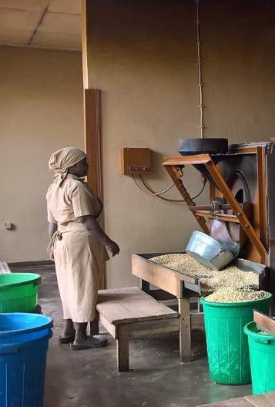
Thank You
www.timeforsense.com

