Slide 1
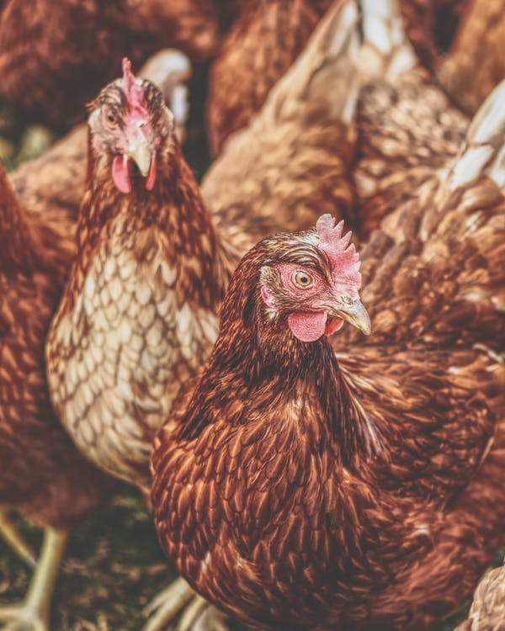



Value chain Quick Scan &
Business Model Selection
September 2021

Slide 2

Method – Project Overview
QUICK SCAN STEP
Desktop Research ▸ Existing Value Chain Studies ▸ Food consumption Studies ▸ Gender & Youth Reports ▸ Fact sheets and statistics ▸ Trade Data
Expert Interviews ▸ Mozambique Sector Experts ▸ International Sector Experts
VALUE CHAIN STEP
BUSINESS CASE STEP
Business Case Fieldwork ▸ Fieldwork to gather final data for business cases
Business Case Modelling ▸ Input data in business models ▸ Verify Data (clean-up fieldwork)
Business Case Brief Development ▸ Develop & Visualize Business Case Briefs
▸Private Sector Fieldwork
▸ Knowledge industry Experts
▸ Development & Government Experts
Mozambique (Interviews)
Exit Meeting/Value Chain Debrief
Value Chain Brief Development
▸ Develop value chain presentation
▸Business model selection
Quick Scan Presentation
Quick Scan Highlights and Recommendations
Complete Scoring Sheet
Agree 5 Value Chains for Next Phase
We are here
Business case selection
Quick Scan Meeting

Slide 3
Business Model Selection:
Poultry Value Chain

Slide 4



Issues and Opportunities in Poultry
Issues
No suppliers of quality feed and other inputs in rural areas
Farmers in some outgrower programs are not making any money due to low sales prices
Dependency on South Africa for incubation eggs and feed makes sector vulnerable
Transport from Maputo to Beira and Nampula complicated and expensive
Small producers lack working capital to produce at a decent scale; even for African standards farmers are small (200heads is normal, African standard is 500 -1000)
Opportunities
The market for chicken and eggs is large and growing at high pace
Egg consumption is relatively high for African standards
Mozambique has a very good feed conversion ratio, due to high quality feed and day-old chicks available and good climate
South Africa provides Mozambique with high quality inputs at good prices
There is both consumption of frozen and live chickens
Good market for offal/ intestines
Input companies are selling 4 month old layers
Challenge 2: Processing Equipment
Modern processing equipment is essential
No professional manufacturers
No professional importers & suppliers
No professional maintenance services

Slide 5

Business Model Selection - Poultry Farms
Poultry Value Chain Map
Large scale integrated poultry processing companies have dominant position in the poultry feed and day-old chicks supply chain.
Day Old Chicks and Feed | Primary Production | Wholesale /Processing | Slaughterhouses | Retail Trade
Day old chicks 60 % . Large poultry processing companies from Maputo.
Small poultry farms . Annual capacity 1,000-5,000 chickens .
Open Markets. Traders offer slaughtering service. Capacity 200-500 chickens weekly.
Small scale distributors. Capacity 300-500 chickens per week.
Open Markets
Day old chicks 40%. Large regional poultry processing companies.
Small Shops
Medium commercial poultry farms Annual capacity 5,000-30,000 chickens.
Medium Processing Companies.
Processing companies have their own slaughterhouse. They slaughter the chicken and sell processed/frozen chicken products in the supermarkets.
Poultry feed 70 % . Large producers in Maputo.
HoReca
Large commercial poultry farms Annual capacity >30,000 chickens. Mostly owned by poultry processing companies.(around 10 % market share).
Large Processing Companies.
Poultry feed 30 % . Regional large feed mills owned by poultry processing companies.
Supermarket Retail Chains
Veterinary Service Providers

Slide 6


Production cycle is short and does not require complex technologies and technical skills.
Business Model Selection - Poultry Farms.
Broiler Live Chicken Farm Model
Step 1: Day Old Chicks
Step 2: Starter
Step 3: Growing
Step 4: Finisher
Step 5: Market
Day: 1
Days: 1-10
Days: 10-20
Days: 20-30
Days: 30-35
Feed Conversion and Weight Gain Per Chicken In 30 Days
Live Weight In 30 Days (Kg) | Total Feed Consumption (Kg) | Feed Conversion Rate (FCR) | Benchmark In Africa
1.3 | 2 | 1.54 | 1.8
Production Cost Per Chicken
Day Old Chick (MT) | Feed (MT) | Veterinary Service/Vitamins (MT) | Total Cost (MT)
60 | 140 | 2 | 202
Income Per Chicken
Total Production Cost (MT) | Fixed Costs (MT) | Market Wholesale Price (MT) | Net Income (MT)
202 | 3 | 240 | 35
Income For Small Farm ( 500 chickens in 30 Days)
Total Production Cost (MT) | Fixed Costs (MT) | Market Wholesale Price (MT) | Net Income (MT)
101,000 | 1,500 | 240 | 17,500
EU 0.55
EU 3.5
EU 270

Slide 7

Model has long production cycle and requires complex set of technical skills related to disease prevention and management.
Business Model Selection - Poultry Farms.
Table Egg Production Model
Step 1: 4 months old chicken
Step 2: Growing
Step 3: Egg Laying
Step 4: Selling
Month: 4
Month: 5
Months: 5-17
Months: 17-18
Table Egg Production Per Chicken In 12 Months
Total Egg Production | Total Feed Consumption (Kg) | Egg Laying Ratio | Good Benchmark In Africa
340 | 40 | 89% | 83%
Production/Investment Cost Per Chicken
17 Weeks Layer Chicken Investment Cost (MT) | Feed (MT) | Veterinary Service/Vitamins (MT) | Total Investment/Production Cost (MT)
650 | 1,800 | 3 | 2,453
Small Farm (500 chickens in 12 Months)
Profit and Loss Summary (MT)
Income From Table Egg Production | 202,000
Income From Selling Retired Chicken | 171,500
Total Income | 373,500
Investment Cost In Layer Chicken | 325,000
Total Net Income | 48,500
Income Per Chicken
Total Production Cost (MT) | Fixed Costs (MT) | Market Wholesale Price Per Egg (MT) | Net Income
1,803 | 3 | 6.5 | 404
Income For Small Farm ( 500 chickens in 12 Months)
Total Production Cost (MT) | Fixed Costs (MT) | Market Wholesale Price Per Egg (MT) | Net Income
901,500 | 1,500 | 6.5 | 202,000
EU 770

Slide 8
Business Models- Shortlist Of Business Models

Slide 9
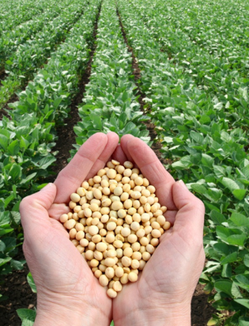
Business Model Selection:
Soy-Bean Value Chain

Slide 10

Issues and Opportunities in Soy-Bean
Issues
Lack of stable market:
  No local soy-bean crushers that take large amounts of soy bean
  Crushers struggle to sell the smaller amounts of oil; not always competitive versus cheap palm-oil imports
  There are tax incentives that lead to crushing plants and oil refineries not being used
  Difficult to compete with imported soy-cake from Argentina: large scale farming and large scale processing, cheap transport
Soy-bean is like maize an extensive large scale farming crop; you need large areas of land with mechanization to have a high income
Other than maize, there is no auto-consumption for soy-bean
In Mozambique there is no processing yet of soy chunks; and requires minimum of 200,000 $ investment
Opportunities
Large poultry sector that is growing fast
Local feed mills that use high quality soy cake
There is one large mill with solvent extraction and another one in the process of being developed
Large local market for cooking oil
Challenge 2: Processing Equipment
Modern processing equipment is essential
No professional manufacturers
No professional importers & suppliers
No professional maintenance services

Slide 11
There are no clear business models
Soy-bean farming is not particularly lucrative or interesting for youth
To improve the market you need to invest in processing
There are large once-off investments, not suitable for the project
Challenge 2: Processing Equipment
Modern processing equipment is essential
No professional manufacturers
No professional importers & suppliers
No professional maintenance services

Slide 12
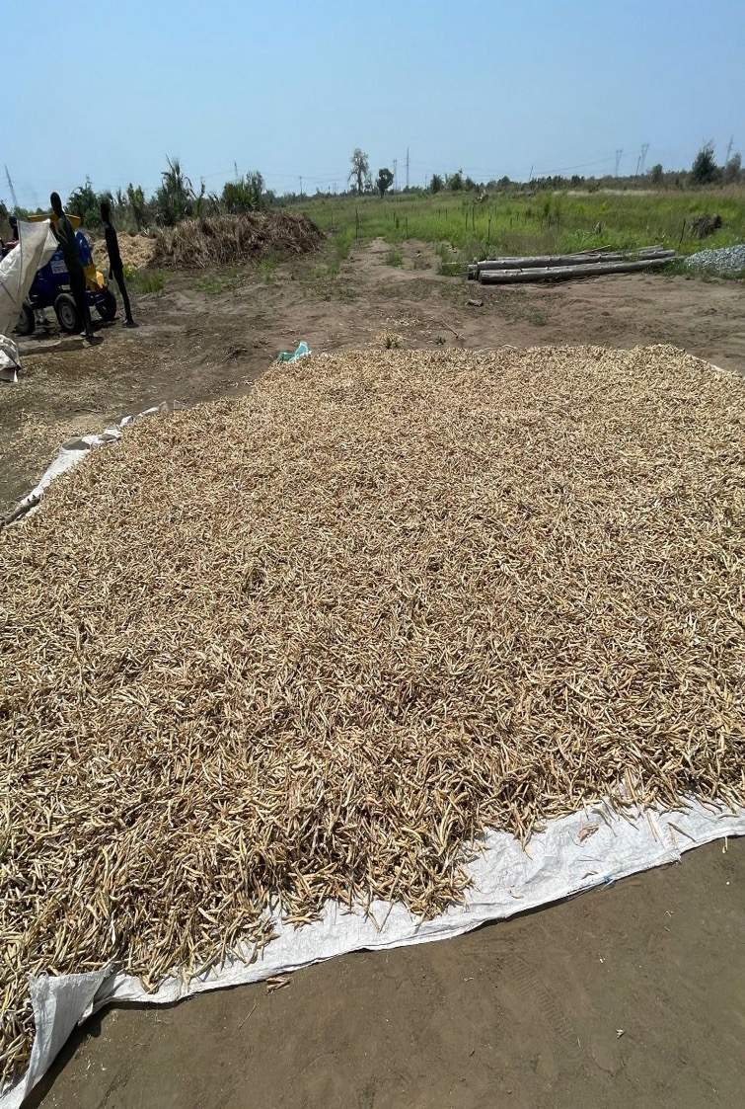
Business Model Selection:
Common Bean Value Chain
Cashew

Slide 13
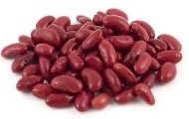
Issues and Opportunities in Common Bean Value Chain
Opportunities
In the irrigated farm the production capacity is 3,5 tons.
Growing demand for bean in the export market.
The price for one kg bean at average is 40% higher per kg compared to other staple crops. For example:
  1kg price bean prices- 55 NT
  1kg maize price- 20 NT
Opportunity for the small scale farmers to earn good income.
For example with 3,5 tons per ha production farmers can get around 90 EU income per month.
Issues
Limited availability of basic seed for the seed. multiplication to produce good quality seed.
Limited knowledge about modern agricultural practices.
Lack of proper irrigation infrastructure; most farmers produce bean without irrigations.
Low production per ha:
  Without irrigation and input materials maximum 1 tons per ha
  With irrigation 3,5 tons per ha
Complex business process to organize and manage outgrower model (at least 500 farmers per model).
Good quality seed is expensive:
  1kg seed prices 180 NT.
  50-60 kg of seed per hectare
  10,800 NT investment in seed per hectare.
Lack of access to working capital and investment loans:
  Working capital loan for seed and input materials per ha -50,000 MT
  Investment loan for drip irrigation- 150,000 MT
Challenge 2: Processing Equipment
Modern processing equipment is essential
No professional manufacturers
No professional importers & suppliers
No professional maintenance services

Slide 14
Business Model 1: Common bean export outgrower model
Product or Service
Employment Impact
Direct FTE (60)
10 people at exporter including extension workers
10 Temporary labour for 1-2 months for sorting and cleaning
Maybe 3 exporters can be created
Indirect FTE
Improved income for 1500 – 4500 farmers
Export company starts outgrower program with small farmers
Provides inputs, notably good seed, purchases and sorts and cleans beans, proper drying
Export to South Africa, India, China in bulk (50kg bags)
Minimum scale is 500 outgrowers if they reach 3,5t/ ha or 1500 if they produce 1t/ ha
Market Entry Difficulty
Entry Point
Entry Barriers
Potential partners:
  Existing exporters
  Define further potential partners
Support needed:
  Access to irrigation equipment
  Farmer training
  Market linkages
Finding entrepreneurs/ companies willing to set-up programs and able to manage them
Good quality seed
Training of farmers
Danger of side-selling
Managing farmers

Slide 15
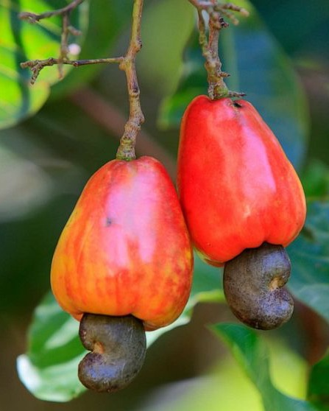
Business Model Selection:
Cashew Value Chain

Slide 16
Issues and Opportunities in Cashew
Issues
Declining production, and poor kernel quality due to diseases and old trees
Lack of proper orchards; most farmers own clumps of individual trees, without regular spacing
High incidence of pests and fungal diseases mean that spraying is now required
Few farmers do maintenance such as pruning
Low planting density even for ‘orchards’(10x10m)
Unclear genetic origin of trees
Some exporters have left the country due to lack of quality and quantity, while others are running far below capacity
Public sector has been responsible for production of seedlings and spraying, pushing out private sector
Very limited local processing
Almost no processing of by-product
Opportunities
Fertile soils suitable for cashew and good climate
lots of land available for planting
Government is retracting from spray services and seedlings, opening space for private sector
Wide acceptance of the need for spraying, over 25% of trees are sprayed
Chemicals and equipment for spraying are widely available, can be imported from SA easily
Local community based spray services have been developed, and farmers are prepated to pay
There is an interest in planting cashew in certain areas
Cashew juice blend bottled on industrial scale is on local market since February and selling well
Strong potential partners available
All stakeholders are aligned regarding the needs for the industry
Challenge 2: Processing Equipment
Modern processing equipment is essential
No professional manufacturers
No professional importers & suppliers
No professional maintenance services

Slide 17
Cashew requires investments in production
There is market for Cashew, but chronic lack of supply of quality kernel
A large part of the trees are beyond rescue, even staghorning will not help
Diseases pressure means spraying is a must, but it is also economical. There is a clear business case for it
Service provision in certain areas is difficult due to long distances between clumps of trees/ small orchards
The solution: we need massive planting of new trees & better maintenance of all orchards
Blocks of at least ½ ha with proper spacing of 8x8, not 10x10
Clustering of producers in same area
Quality trees are necessary: high production, kernel quality, compact dwarf varieties
We need to increase maintenance to existing orchards to increase productivity and quality
All stakeholders agree we need to promote nurseries and maintenance service providers!

Slide 18
Business cases in processing are less clear
Kernel Processing in Africa is difficult, let alone in Mozambique where the quality and supply are very low
There are a few initiatives with direct marketing channel, but these organisations are better suited to promote nurseries and services. Kernel Processing is not a model that can be replicated easily
Cashew Apple is challenging:
  Artisanal juice is possible due to availability of single use glass, but better equipment is needed, which is expensive ($20,000)
  Cashew apple collection is difficult in many areas due to the lack of proper orchards
  Stakeholder is interested in replacing imported Brazilian pulp, but this would require investment in a juicing plant.
  Volumes for now are also limited to 20tons/ month, or 240 tons per year.
  Potential partner project, but it will be 2-3 years before the 300,000 new cashew trees comes into production

Slide 19
Business Model 1: Professional local nurseries producing quality cashew and other trees
Product or Service
Employment Impact
Direct FTE (480)
Manager and 3 Staff in full time employment
Replacing 15 million trees in Nampula over 10 years means 1,5 mln trees are needed. Sofala already plants 300,000 trees per year, but has more potential. 3 million trees per year require 120 nurseries doing 25,000 cashew plus 25,000 other trees
Indirect FTE
Orchard maintenance for new fruit trees
Planting
Harvesting
Small professional decentralized nurseries
Production of 25,000 to 50,000 trees under shadecloth close to a source of water for irrigation
Sell grafted cashew seedlings, as well as citrus, mango and other trees to community
Has tricycle for delivery
Training and seedlings can be co-financed by off-takers in exchange for contracted supply
Can be combined with orchard maintenance service
Market Entry Difficulty
Entry Point
Define potential partners:
Support needed:
  Training in nursery management and production
  Set-up of certification system
  Access to small finance for set-up
  Promotion of planting amongst farmers
Entry Barriers
Ability and interest of farmers to buy trees

Slide 20
Business Model 2: Cashew Orchard Maintenance service
Product or Service
Employment Impact
Direct FTE: 12500
One team can spray 80 trees/ day, and there are 20 days to spray them, so 1600 trees per team/ year
Nampula has 15mln trees, Sofala 5 million?
We need 12,500 teams of 2 people for all trees
If spraying is increase from 25% to 50% of trees we need 6250 teams of 2 people
For pruning we need 6 additional people
Independent Service Provider managing a range of village based orchard maintenance groups
Services include spraying of pesticides, fungicides and foliar fertiliser; fertiliser application and pruning & planting and or harvesting and trade
Other tree crops can be added
Business owner distributes product to the village based teams on a weekly basis
One company works with 10-30 local teams
Market Entry Difficulty
Entry Point
Potential partners:
  Cashew Exporters & Cashew processors
  Existing spray service providers
  Input dealers for inputs and equipment
  + further potential partners
Support needed:
  Training in pruning and spraying & fertiliser application
  Access to finance for equipment
  Linking with input providers
Entry Barriers
Ability of farmers to pay for services, particularly up front
Technical skills
Access to finance

Slide 21
Business Model 3: Small Modern Cashew Farmer
Product or Service
Employment Impact
Improved incomes for 200,000 farmers in Nampula and 50,000 in Sofala
Small producer of Cashew with renovated or new orchard of 1ha with 130 to 160 trees
Uses maintenance services
Linked to input dealer and offtaker
Market Entry Difficulty
Entry Point
Potential partners:
  Cashew Exporters & Cashew processors
  Existing spray service providers
  Input dealers for inputs and equipment
  + further potential partners
Support needed:
  Farmer business school
  Outgrower program that provides some credit to pay for inputs and services
Entry Barriers
Ability of farmers to pay for services, particularly up front
Convincing farmers to rennovate old orchard and or invest in new ones
Access to finance to pay for spray services etc.

Slide 22
Business Model 4: Artisanal Cashew Apple juice
Product or Service
Employment Impact
One juice producer provides income to 10 seasonal jobs in factory and a harvesting team of 8
10 micro plants would provide 180 jobs
Small producer of Cashew with renovated or new orchard of 1ha with 130 to 160 trees
Uses maintenance services
Linked to input dealer and offtaker
Market Entry Difficulty
Entry Point
Potential partners:
  Cashew Exporters & Cashew processors
  Existing spray service providers
  Input dealers
  + further potential partners
Support needed:
  Training in harvesting
  Training in juice processing
  Training in bottle collection systems
  Training in marketing and distribution
  Financial management training
Entry Barriers
High cost of proper equipment: $20,000 + a building
Gathering of apples requires harvesting from trees, potentially with harvesting teams
Difficult business: requires fruit collection, bottle collection, processing, marketing and distribution skills: lots of skills needed
Drink will always remain a premium product because of packaging cost and lack of economies of scale

Slide 23
Conclusion: Final Ranking Of Business Models.
Product or Service
Rank | Business model | Direct FTE | Indirect FTE | Complexity | Impact on other sector actors
1 | Orchard maintenance | 12,500 |  | Medium | High
2 | Nursery | 480 |  | Low | High
3 | Modern farmer (requires maintenance service) |  |  | Medium | High
4 | Artisanal juice | 180 |  | High | low

Slide 24
Business Model Selection:
Honey

Slide 25

Issues and Opportunities in Honey
Issues
Market uncertainty: how much can the local market absorb?
International market access: Mozambique is not on the EU list, though apparently organic certification can solve this
Competition from cheap Chinese honey, often adulterated
Impact of natural disasters such as flooding is high
Deforestation leaves limited space to place hives in certain areas, and flowers for production of nectar
Use of pesticides & herbicides in agriculture can lead to death of bees and colonies if not managed properly
Gathering of honey can be complicated
Opportunities
Lucrative low risk activity: Low investment cost, no cost of production
There seems to be national demand for honey in Mozambique
International market for wax and propolis
Synergy with cashew production, can increase yields substantially, but requires coordinated spraying
Synergy with other tree crops, though there are few plantations currently
Has positive effects on deforestation and avoiding forest fires; ideally you have a ‘buffer zone’of hives around your cashew orchard
Challenge 2: Processing Equipment
Modern processing equipment is essential
No professional manufacturers
No professional importers & suppliers
No professional maintenance services

Slide 26
Business Model 1: Honey outgrower model
Product or Service
Employment Impact
Direct FTE (40)
10 people per processor, max 4 processors
You need about 3000 to 10,000 hives as a processor
1000 to 3000 producers with 3-4 hives each
1 technical assistant per 200 producers
Indirect FTE
Additional income of 3600Mzm for 4000 to 12,000 producers
Scale is dependent on being able to find an export market!!
Company trains small producers in honey production and provides them with access to hives and wax to attract bees
Harvesting is done by collectors/ extension officers on motorbike with bee suit (avoid having to invest in hundreds of suits)
Company process honey, packages and sells; local market and or export
Activity can be combined with cashew:
  Maintenance service providers can be collectors
  Cashew farmers can be producers (hive owners)
Market Entry Difficulty
Entry Point
Entry Barriers
Define potential partners:
Support needed:
  Integration into cashew models
  Development of business model
  Access to finance/ donor money for hives
  Export market development
Cost of hives: 3000Mzm per hive that can make 12kg*75Mzm=900Mzm per year
Size of local market: 10,000 hives is 120 tons of honey! Mozambique imported a total of 249 tons in 2020, of mostly cheaper honey from China (via SA)
Mozambique currently cannot export
Honey in itself is not economically sustainable, it will need to be an add-on activity for farmers and processors

Slide 27
Conclusion: Final Ranking Of Business Models.
Product or Service
Rank | Business model | Direct FTE | Indirect FTE | Complexity | Impact on other sector actors
1 | Honey outgrower model | 40 | 4000 - 12000 | High | Low

Slide 28
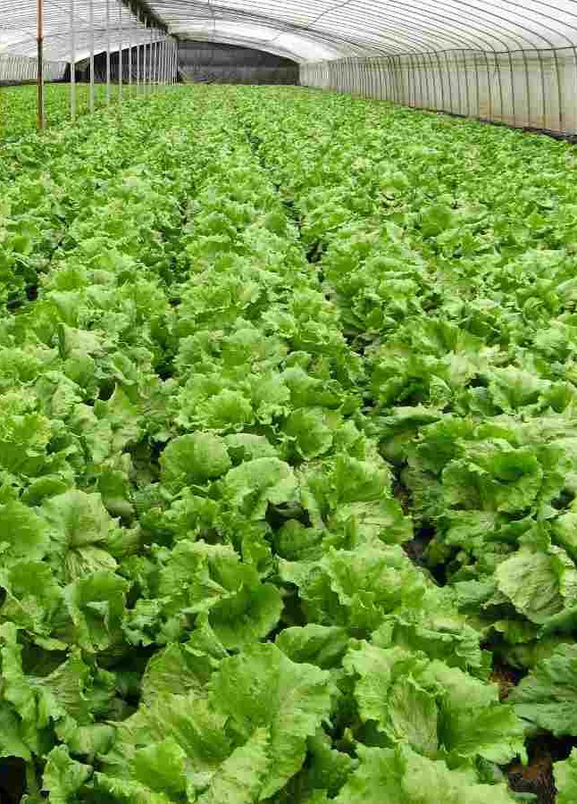
Business Model Selection:
Vegetable Value Chain

Slide 29
Issues and Opportunities in Vegetables
Issues
Overproduction during rainy season
Lack of inputs in rural areas
Poor market linkages & market structure: producers want to go by themselves to the market and are often forced to sell at low prices
Poor logistics and infrastructure leading to high post-harvest losses and lack of quality (crates, sorting and grading, cold storage, trucks)
Lack of quality seed access
Opportunities
High demand in dry season
Institutional market demanding quality vegetables
High Interest and many success stories in modern production: irrigation & greenhouses
Seed multiplication
Rural input supply
Challenge 2: Processing Equipment
Modern processing equipment is essential
No professional manufacturers
No professional importers & suppliers
No professional maintenance services

Slide 30
Business Model 1: Modern dry season production of vegetables
Product or Service
Employment Impact
Direct FTE
Indirect FTE
Farmer obtains irrigation equipment and potentially greenhouses
Produces a variety of vegetables throughout the year
Main market is dry season local market and institutional buyers looking for consistent supply of quality vegetables
Will require outgrower model with trader to link smaller farmers
Market Entry Difficulty
Entry Point
Entry Barriers
Potential partners:
  Supermarkets
  Mines, large institutions
Support needed:
  Identification of equipment
  Access to finance
  Market linkages
  Technical training
Investment cost in equipment
Market linkages
Technical skills

Slide 31
Business Model 2: Vegetable outgrower model
Product or Service
Employment Impact
Direct FTE: 100-200
20 people per company (collection, technical assistance, processing, transport, management
Project can create maybe 5 - 10 companies
Indirect FTE: 1000 - 2000
Improved market access and input access and profitability for vegetable farmers
Contract can help with access to finance for irrigation equipment, greenhouses
Company providing inputs (e.g. quality seed) to producers
Buys a variety of vegetables throughout the year
Washes, grades and sorts product, potentially has cold storage
Sells different grades to different markets/ clients
May invest in cold storage
Works with 10-200 small farmers
Market Entry Difficulty
Entry Point
Entry Barriers
Potential partners:
  Supermarkets
  Mines, large institutions
  Projects supporting vegetable farmers
Support needed:
  Access to finance
  Market linkages
  Technical training
Investment cost in equipment, vehicles, crates
Market linkages
Technical skills: technically difficult and perishable products, complex business model
Finding the right entrepreneurs

Slide 32
Conclusion: Final Ranking Of Business Models.
Product or Service
Rank | Business model | Direct FTE | Indirect FTE | Complexity | Impact on other sector actors
1 | Vegetable outgrower model |  |  | High | low
2 | Dry season vegetable production |  |  | High | Low

Slide 33
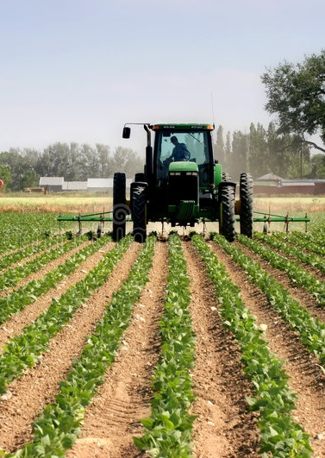
Business Model Selection:
Cross Cutting Business Models

Slide 34
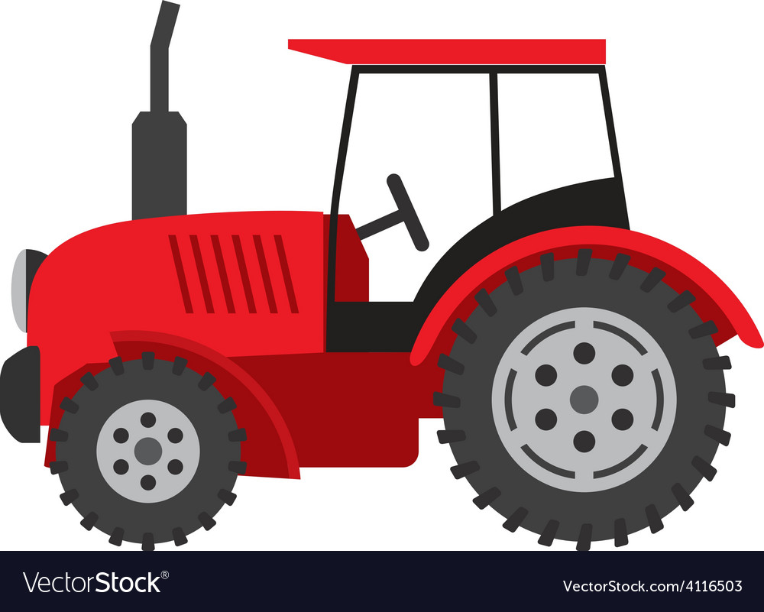
Cross cutting Issues and Opportunities
Issues
Lack of access to (quality) inputs outside of urban and peri-urban areas
Input quality
Lack of access to market/ structured marketing channels
Lack of mechanization services
Poor rural infrastructure
Lack of skilled staff, even university educated agronomists have 0 practical skills
Lack of respect for contracts & loan agreements, fraud and theft
Development projects that offer perverse incentives and distort markets
Opportunities
Very competitive market of entrepreneurial input dealers looking for rural distribution
Input dealers already import equipment and provide maintenance services and stock spare parts
Proximity to South Africa makes inputs and equipment easier to import
Farmers are willing to invest in quality inputs; many rural savings groups use savings for input or trading
Private companies willing to link small farmers to market
Large availability of fertile land close to water sources, even for youth
Closeness to port opens up markets
Challenge 2: Processing Equipment
Modern processing equipment is essential
No professional manufacturers
No professional importers & suppliers
No professional maintenance services

Slide 35
Business Model 1: Rural input dealer & commodity trader
Product or Service
Employment Impact
Direct FTE: 400 to 800
1-2 per micro enterprise
800,000 to 1,000,000 farmers in Nampula and Sofala
1 input dealer/ trader can service 500 farmers
Space for 1600 to 2000 dealers
More realistic: 50 dealers for 4 input companies over 2 provinces= 400 dealers, is 400 to 800 FTE
Entrepreneur with tricycle purchases and picks up inputs from private input supplier in urban area or rural distribution point
Travels to rural areas to sell to small scale farmers
Provides agricultural advice to farmers
Optional: spraying service
Can also purchase crops from farmers for sale to wholesalers, processors or exporters
Works for beans, poultry, vegetables
Market Entry Difficulty
Entry Point
Entry Barriers
Potential partners:
  Input dealers
  Seed companies
  Commodity traders/ wholesalers for beans, maize, soybean, vegetables
  Finance
Support needed:
  Access to finance
  Market linkages
  Technical training
  Basic finance and economics
Investment cost in vehicle
Market linkages
Technical skills training
Access to capital of farmers

Slide 36
Business Model 2: Seed multiplication & production
Product or Service
Employment Impact
Direct FTE: 60 -100
Seed multiplication company has 100 to 200 outgrowers + core plantation
Around 20 jobs per seed company
Creation of 3 companies can provide 60 jobs in company plus staff at core farm plus farmers
Indirect FTE: 300 to 600 seed multiplication farms
Company imports or produces basic seed, and has network of outgrowers who produce certified seed
Company cleans seeds and packages, sells seed via mobile input dealers and input dealer shops
Has research to find varieties suitable for local context
Vegetables, soybean, maize, beans are best candidates
Market Entry Difficulty
Entry Point
Entry Barriers
Potential partners:
  Input dealers: develop this activity of own seed production with them
  Seed companies: help them to grow network of outgrowers for seed multiplication
Support needed:
  Access to finance
  Market linkages
  Technical training
  Basic finance and economics
Investment cost in vehicle
Market linkages
Technical skills training
Access to capital of farmers
Access to foundation seed
Selection of right varieties for local context

Slide 37
Business Model 3: Mechanisation service
Product or Service
Employment Impact
Direct FTE: 100
2 people per tractor: 1 for sales & planning, 1 driver
Hundreds of tractors are needed, but how many entrepreneurs can get finance and training? 50 – 100 would be quite a task to manage
Indirect FTE:
Private company has 1 or more tractors with implements
Provides services for farmers: land clearing, land preparation, planting, spraying, fertiliser, harvesting, post harvest processing, transport
Fee per ha or ton charges to farmer
May want to work in outgrower scheme so that farmers have access to finance and market
Market Entry Difficulty
Entry Point
Entry Barriers
Potential partners:
  Input dealers
  Outgrower schemes
Support needed:
  Access to finance
  Tractor driver training
  Intensive business coaching
  Basic finance and economics
  Mechanics training
  Selection and importation of right equipment, development of maintenance and repair service
High Investment cost per model: $50,000
Farmers have small plots spread out over large areas: clustering needed
Lack of well cleared and demarcated fields
Access to capital of farmers to pay for services
Lack of local tractor dealers of reputable brands who hold spare parts and provide breakdown service
Very complex business
Where do you find suitable tractor driver-entrepreneurs?

Slide 38
Conclusion: Final Ranking Of Business Models.
Product or Service
Rank | Business model | Direct FTE | Indirect FTE | Complexity | Impact on other sector actors
1 | Rural input dealer & commodity trader | 400-800 |  | Medium | High
2 | Seed multiplication and production | 60 - 100 | 300 - 600 | High | Medium
3 | Mechanisation service | 100 - 200 |  | High | High

Slide 39
Conclusion: Recommended Models

Slide 40
Conclusion: Proposed business models
Product or Service
Rank | Business model | Direct FTE | Indirect FTE | Complexity | Impact on other sector actors
1 | Meat chicken farm small & medium | 1000 |  | Easy | Medium
2 | Layer farm | 1000 |  | Medium | Medium
3 | Poultry trader | 500 |  | Easy | High
4 | Rural input dealer & commodity trader | 400-800 |  | Medium | High
5 | Orchard maintenance | 12,500 |  | Medium | High
6 | Nursery | 480 |  | Low | High
7 | Modern farmer using maintenance service |  |  | Medium | High

Slide 41
Conclusion: Maybe business models
Product or Service
Rank | Business model | Direct FTE | Indirect FTE | Complexity | Impact on other sector actors
1 | Seed multiplication and production | 60 - 100 | 300 - 600 | High | Medium
2 | Mechanisation service | 100 - 200 |  | High | High
3 | Vegetable outgrower model |  |  | High | low
4 | Dry season vegetable production |  |  | High | Low
5 | Honey outgrower model | 40 | 4000 - 12000 | High | Low
6 | Common bean outgrower model | 50-60 | 2000 | High | Low
Advice: pick 1 model from the maybe list that can be combined with the others, and for which implementation is not too difficult

Slide 42

Next Steps.
Next steps
Sep-Oct
Task 1 | Agree with GiZ about final shortlist of business models
Task 2 | Draft business case model
Task 3 | Discuss draft version of the models with field team
Task 4 | Present draft version of the models to GiZ
Task 5 | Update the comments of GiZ
Task 6 | Submit final version of the business case models

Slide 43
For more information, contact
info@timeforsense.com

